Slide 1
An Informational Webinar ACADEMIES OF NASHVILLE
National Center for College & Career Readiness I Drexel University School of Education
January 28, 2014

Slide 2
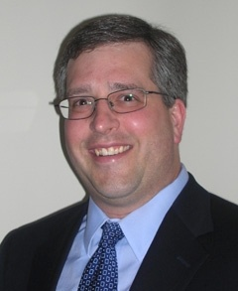
Every Teen with a Dream and Plan,
Every Community with a Capable, Ready Workforce
The National Center for College and Career Transitions (NC3T) provides planning, coaching and technical assistance to help community-based leadership teams plan and implement their college-career pathway systems.
HANS MEEDER
BRETT PAWLOWSKI

Slide 3
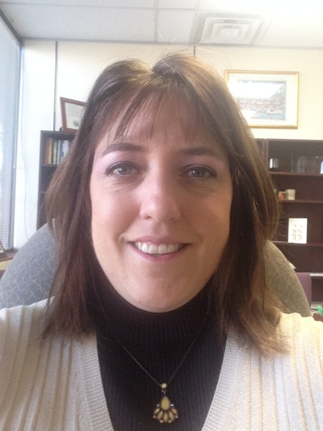
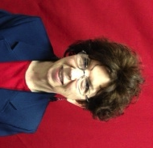
Today’s Presenters
Dr. Aimee Wyatt
Executive Lead Principal for High Schools for Metropolitan Nashville Public Schools
Pioneered the development of small learning communities in the Nashville area
Has served as a middle and high school teacher, assistant principal, and executive principal for 20 years in both Tennessee and Louisiana.
Paula Barkley
Over 31 years of teaching; multiple teaching awards including: Teacher of the Year at McGavock, Metro High School Teacher of the Year, Donelson-Hermitage Teacher of the Year, Academies of Nashville Academy Coach of the Year (2012), and NCAC Educator of the Year (2012)
Assumed the position of Site Coach in 2007; evolved to the current Academy Coach position.
Aimee Wyatt
Paula Barkley

Slide 4
Enter presenters’ slides

Slide 5
NC3T Pathways System
Graduates Ready for Career/College/Civic Life
Academic Learning Skills
Transferable Work-Readiness Skills
Career Navigation Skills
1. Community Integration
2. Middle School Exploration
3. Career-College Pathways
Shared Vision for Youth
Themed Pathways that Address Needs and Interests of All Students
Career Exploration
Leadership Structure
Employer/Community Engagement
Workforce Alignment
Postsecondary Connections
System Measurement
Communication Strategy
21st Century Skills
Financial and Enterprise Literacy
Exploration of 9-14/16 Pathways
Academic and Social Supports
Personalization
Teacher and Counselor Collaboration
Employer-Connectedness
Student Leadership Development

Slide 6
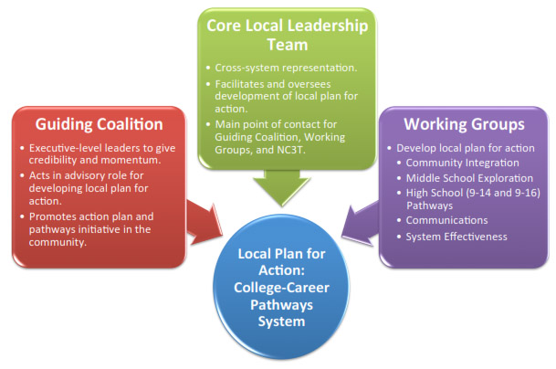
Pathways Planning Structure

Slide 7
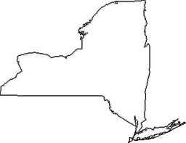
State-Sponsored Pathways Innovation Networks
Pennsylvania Sites
Kingston, PA
Latrobe, PA
Bucks County, PA
New York Sites
Johnstown, NY
Long Island PIN, NY
Montrose, NY
Malone, NY
◉
◉
◉
◉
◉
◉
◉

Slide 8
NC3T Resources
The STEM Leader Guide
Practical step-by-step guide to building a STEM culture. Available on Amazon.
Building Advisory Boards That Matter
Engage employer partners and other stakeholders and improve program results and community buy-in. Available from ACTE at ACTEonline.org

Slide 9
Contact Information
Hans Meeder
President
443-878-3503
Hans@NC3T.com
Brett Pawlowski
Executive Vice President
704-717-2864
Brett@NC3T.com
HANS MEEDER Former Deputy Assistant Secretary at the U.S. Department of Education, respected national leader conducting research and providing technical assistance on high school redesign, career and technical education, and workforce development. Hans also serves as President of the Meeder Consulting Group.
BRETT PAWLOWSKI NC3T Executive Vice President, published widely on the topic of business/ education engagement and has worked with businesses, nonprofits, and others on building effective education engagement programs. Brett also serves as President of DeHavilland and Associates.

