Slide 1
The Next Downtown
Bruce Katz, Co-Founder and Director, Nowak Metro Finance Lab, Drexel University
June 2023

Slide 2
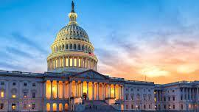
Contents
The Downtown Crisis
An Economy in Transition
Early Policy Signals
What Comes Next?

Slide 3
Impacts of Remote Work
Small businesses that used to be frequented by office workers saw their customer bases shrink
Less foot traffic
As fewer workers came into the city, public transit ridership started to decline
Less need to commute
Remote
Work
Dwindling Tax Bases
Less need for the office
Employers started questioning their use of office space, making the commercial real estate industry vulnerable
Many office workers are staying home 2-3 days a week.
Various cities across the country are now facing budget shortfalls in upcoming years
Less need for proximity
Remote workers started moving out of city centers into cheaper neighborhoods

Slide 4
Office markets have yet to recover from WFH policies—combined with inflationary rates and high costs, the commercial real estate industry could be facing havoc
“MS & Co. analysts forecast a peak-to-trough CRE price decline of as much as 40% [this year], worse than in the Great Financial Crisis…commercial real estate, already facing headwinds from a shift to hybrid/remote work, [will have to] refinance more than half of its mortgage debt in the next two years,”
--Lisa Shalett, chief investment officer for Morgan Stanley Wealth Management, April 2023**
*Source: Cushman & Wakefield US Office Market Beat Report, Q1 2023
**Source: https://www.foxbusiness.com/economy/commercial-real-estate-market-could-crash-soon-heres-why
Notes:
Office properties below Class A are particularly vulnerable

Slide 5
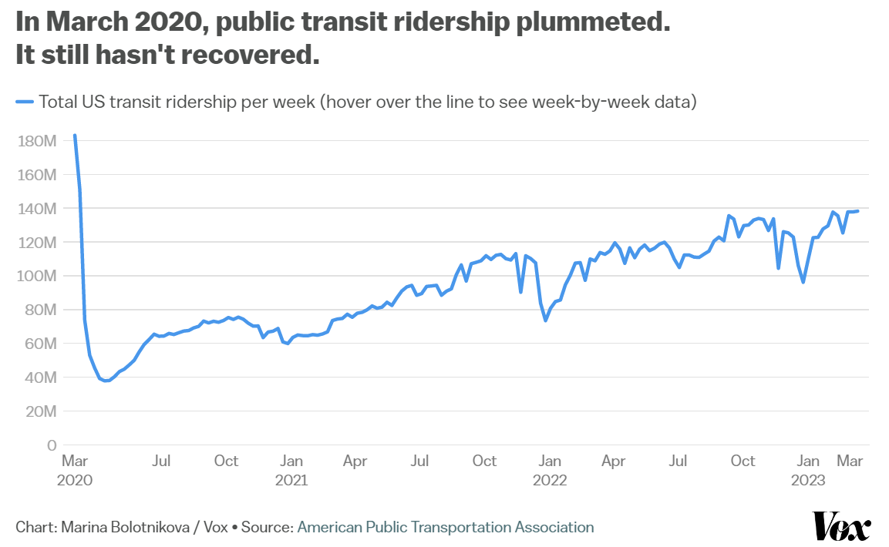
Ridership has fallen through the floor, with obvious implications for revenues and services
“BART has recovered just 40% of its ridership and faces disaster by early 2025 when federal pandemic funding runs out. If ridership doesn’t rebound significantly, the agency could be forced to stop weekday trains by 9 p.m., eliminate weekend service, close some stations, institute 60-minute wait times for trains and lay off staff.”
--Heather Knight, SF Chronicle
Notes:
This is just a sample of ciies

Slide 6
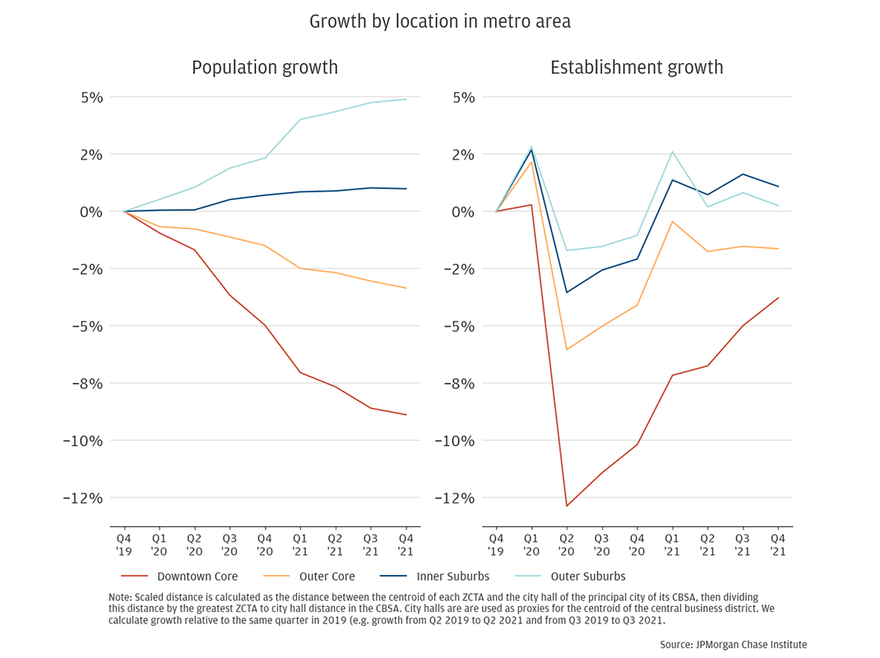
On top of it all, downtowns are still struggling to recover pre-pandemic population or business levels—policymakers are now considering what may become new norms
An analysis of 16 cities from JP Morgan Chase indicates that downtown cores have yet to reach pre-pandemic level of population and business establishments.
“The shape of the challenge for an economic development entity in a city is to now figure out what kinds of businesses are going to work here, what kinds of services are going to be needed in a place that has a different population trajectory,”
--Christopher Wheat, president of the JPMorgan Chase Institute, March 2023*
*Source: https://www.bloomberg.com/news/articles/2023-03-01/as-retail-stores-close-downtown-new-ones-open-in-suburbs
Notes:
These are Atlanta, Chicago, Columbus, Dallas-Ft. Worth, Denver, Detroit, Houston, Los Angeles, Miami, New Orleans, New York, Phoenix, Portland, San Diego, San Francisco, and Seattle. We define a city as the collection of ZCTAs that most closely match the boundaries of the Census-defined Core-Based Statistical Area.

Slide 7
Metro economies with tax bases dependent on office property may be facing fiscal cliffs after federal aid ends
In San Francisco, the Budget and Analysis Division and the Controller’s Office of San Francisco project a budget shortfall of ~$780 million in the next two fiscal years, and of $1.3 billion in FY 2027-2028 without any corrective action.
In Philadelphia, the $1.4 billion cushion from ARPA has been crucial to maintaining fiscal health—without ARPA, the city was facing a $1.5 billion budget gap over the last five-year plan.
In Madison, WI, the projected budget shortfall in 2023 was ~$13 million. By 2026, the projected budget shortfall is almost ~$30 million.
In Rochester, NY, a gap for all funds of approximately $88.8 million is expected for 2024-25. This gap accumulates to $156.3 million in 2028-29.
In Houston, TX, COVID-19 relief funds are being used to mitigate the projected $160 million spending deficit for 2024.
Sources: https://stories.opengov.com/rochesterny/published/v-ZKYanzy; https://abc13.com/city-of-houston-budget-2024-proposed-spending-vs-revenue-issues-mayor-sylvester-turner/13261606/; https://wispolicyforum.org/wp-content/uploads/2022/10/2023BudgetBrief_CityofMadison.pdf; https://www.phila.gov/media/20230301214628/operating-and-capital-budget-presentation-FY2024.pdf; https://sf.gov/sites/default/files/2023-03/March%20Update%20FY%2023-24%20through%20FY%2027-28.pdf
Notes:
This is just a sample of ciies

Slide 8
Contents
The Downtown Crisis
An Economy in Transition
Early Policy Signals
What Comes Next?
Notes:
This section should focus on the distributed nature of industrial production — which is a good thing

Slide 9
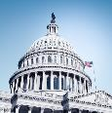
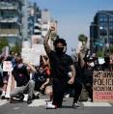
“The New Disorder”
COVID-19 Disruptions
Unprecedented Federal Spending
Inflation, Credit Crunch & Rising Interest Rates
War in Ukraine
Rising Tensions with China
Renewed Calls for Racial Justice
The Climate Crisis
Remote
Work
“The pandemic, and now geopolitical upheaval, have taken the economy and shaken it up like a snow globe. The flakes will eventually fall – there will be a new equilibrium – but things may be arranged differently when everything settles.”
Jeanna Smialek, New York Times, March 25, 2022

Slide 10
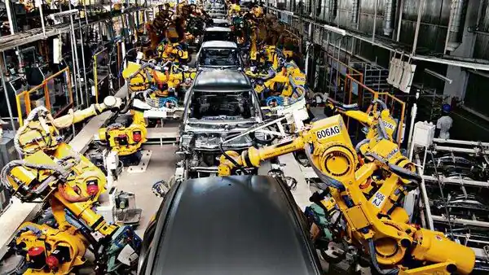
“The CHIPS Act, along with the Inflation Reduction Act and its $369bn in grants and tax credits for the rollout of renewable energy are the most significant attempts to revive industrial policy in the capitalist world since the aftermath of the second world war”
—Anne-Sylvain Chassany
Financial Times, March 5, 2023
“America is accelerating its military containment of China in Asia, rejuvenating old alliances and creating new ones .... In commerce and technology, America is enacting a tough and widening embargo on semiconductors and other goods. The goal is to slow Chinese innovation in order that the West can maintain its technological supremacy: why should America let its inventions be used to make a hostile regime more dangerous?
—The Economist
April 1, 2023

Slide 11
Some of these mega forces have catalyzed a fundamental shift in the prevailing paradigm
Disruptive Mega Forces
Catalysts for change
New Industrial Paradigm
COVID-19
Exposed vulnerability of supply chains
Reshoring
War in Ukraine
Prompt a review of U.S. defense
Remilitarization
Rising tensions with China
Renewed importance of domestic manufacturing
Decarbonization
The climate crisis
Commitment to decarbonize the economy
Sources: The Biden-⁠Harris Plan to Revitalize American Manufacturing and Secure Critical Supply Chains in 2022; Remarks by U.S. Secretary of Commerce Gina Raimondo: The CHIPS Act and a Long-term Vision for America’s Technological Leadership.
Notes:
The United States is pursuing a modern industrial and innovation strategy that includes strategic public investment to protect economic and national security interests.
The strategy includes securing critical infrastructure, advancing foundational cybersecurity, securing supply chains, and using public procurement to stimulate demand for innovation.
The largest investment in physical infrastructure in nearly a century has been enacted, including historic investments in transportation, broadband, clean water, and energy infrastructure.
The semiconductor industry is seen as important to competitiveness and national security, and the CHIPS and Science Act authorizes $280 billion for civilian investment in research and development, especially in critical sectors such as semiconductors and advanced computing.
The National Biotechnology and Biomanufacturing Initiative is investing more than $2 billion to harness the full potential of biotechnology and biomanufacturing, create jobs, strengthen supply chains, and reduce carbon emissions.
The Inflation Reduction Act will invest in domestic energy production and manufacturing, reduce carbon emissions by roughly 40 percent by 2030, and hasten the clean energy transition.
The strategy prioritizes equity and investing in regional economic development to ensure the future is made across all of America, by all Americans.
The US is also protecting its investments and bolstering their resilience through tracking, attributing, and defending against the activities of malicious actors in cyberspace, countering intellectual property theft, and forced technology transfer.

Slide 12
The new paradigm has led to unprecedented federal spending for a competitiveness agenda centered in modern supply side economics
American Rescue Plan: $1.9T to address the economic and health impacts of the pandemic
Mar 2021
“I will use the term ‘modern supply side economics’ to describe the Biden Administration’s economic growth strategy, and I’ll contrast it with Keynesian and traditional supply-side approaches. [...]
Modern supply side economics, in contrast, prioritizes labor supply, human capital, public infrastructure, R&D, and investments in a sustainable environment. These focus areas are all aimed at increasing economic growth and addressing longer-term structural problems, particularly inequality.”
Bipartisan Infrastructure Law (BIL): $1.2T, the largest investment in physical infrastructure.
Nov 2021
Executive Order 14017: cabinet agencies must devise strategies for strategic supply chains.
Feb 2022
CHIPS and Science Act: $280B for R&D, particularly in semiconductors and advanced computing.
Aug 2022
Inflation Reduction Act (IRA): $437B to cut carbon emissions and accelerate the energy transition.
Aug 2022
Janet L. Yellen,
World Economic Forum, Jan 21, 2022
DOD’s 2023 Appropriations bill: $798B to develop, maintain, & equip military forces and intelligence
Sep 2022
Source: Remarks by Secretary of the Treasury Janet L. Yellen at the 2022 'Virtual Davos Agenda' Hosted by the World Economic Forum, January, 2022.

Slide 13
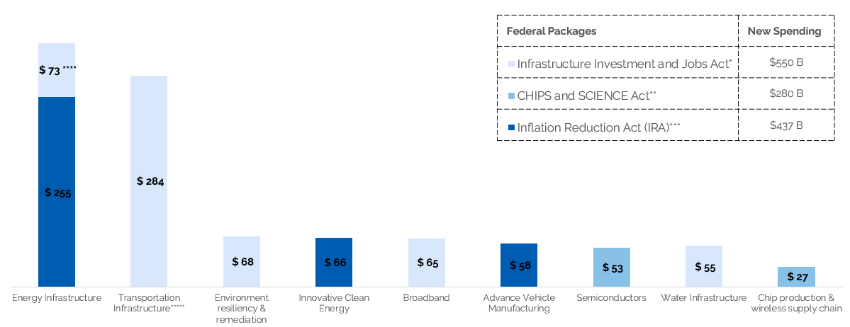
These investments are targeting strategic areas, including energy, transportation, and manufacturing
BIL, CHIPS Act and IRA spending for selected sectors. In billions.
Notes: (*) The BIL allocates an estimated $1.2 trillion in total funding over ten years, but only $550 billion in allocations is new spending during the next five years. (**)This figure includes $200 B allocated for scientific R&D and commercialization initiatives. (***) The IRA is focused on clean energy, making investments across a wide range of sectors, such as energy ($250.6B), manufacturing ($47.7B), environment ($46.4B), transportation and EVs ($23.4B), agriculture ($20.9B),and water ($4.7B). (****) Funds to upgrade power infrastructure and grid automation, including clean-energy technology. (*****) The BIL has funding for roads and bridges; passenger and freight rail; airports, ports, and waterways; public transit; electric vehicles; safety; and reconnecting communities. Source: own elaboration based on The Inflation Reduction Act: Here’s what’s in it, McKinsey; The US Bipartisan Infrastructure Law: Breaking it down, McKinsey; The Inflation Reduction Act: Here’s what’s in it, McKinsey; The CHIPS and Science Act:Here’s what’s in it McKinsey.
Notes:
BY sector:
IRA https://www.mckinsey.com/industries/public-and-social-sector/our-insights/the-inflation-reduction-act-heres-whats-in-it
BIL https://www.mckinsey.com/industries/public-and-social-sector/our-insights/the-us-bipartisan-infrastructure-law-breaking-it-down
Unprecedented Influx of federal infrastructure, innovation, and climate dollars —three major federal packages already in deployment

Slide 14
Several states are making major moves to take advantage of incoming funding and investments
Aggressive Manufacturing Incentives
New Centers of Excellence
Regional Economic Development
Detroit Center of Innovation, Michigan Central, and Wayne State: $100M each to advance research, innovation, and entrepreneurship
Intel in Ohio: $1B+ incentives for Intel’s new plant in Licking County (job creation tax credit; roads, sewage, and water projects)
Micron in New York: $10B Green CHIPS Bill to attract big manufacturers to the state
California Economic Resilience Fund: $500M Community Economic Resilience Fund for regional economic strategies
Connecticut Innovation Corridor: $100M for regional economic clusters
Indiana Regional Economic Acceleration & Development Initiative: $500M for regional strategic investments
Source: New Localism Associates.

Slide 15
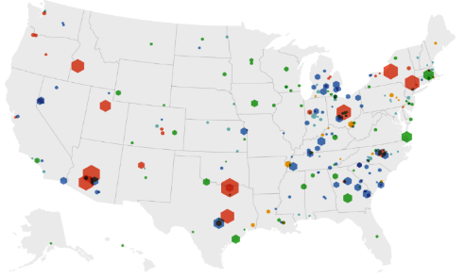
This has resulted in a highly-distributed manufacturing boom across the country, following a decades-long trend of dispersed production in the United States
Private investment during current administration in selected industries

Slide 16
Contents
The Downtown Crisis
An Economy in Transition
Early Policy Signals
What Comes Next?
Notes:
This section should focus on the distributed nature of industrial production — which is a good thing

Slide 17
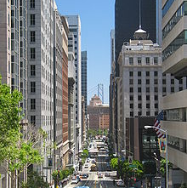
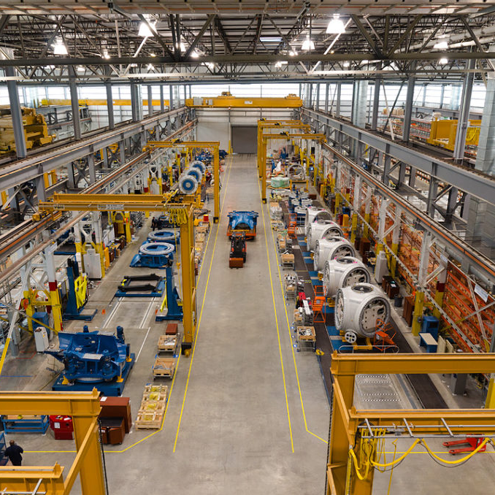
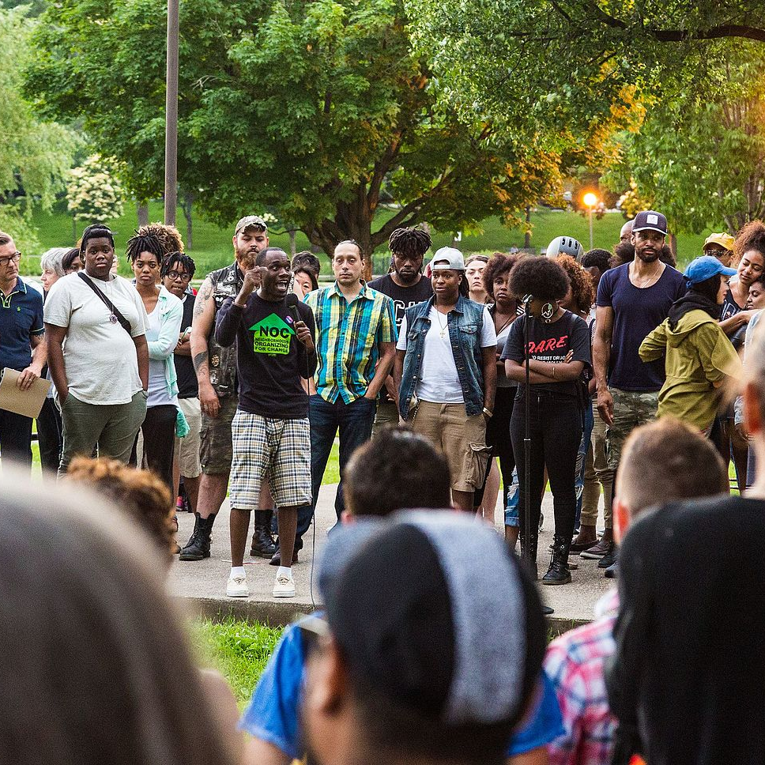
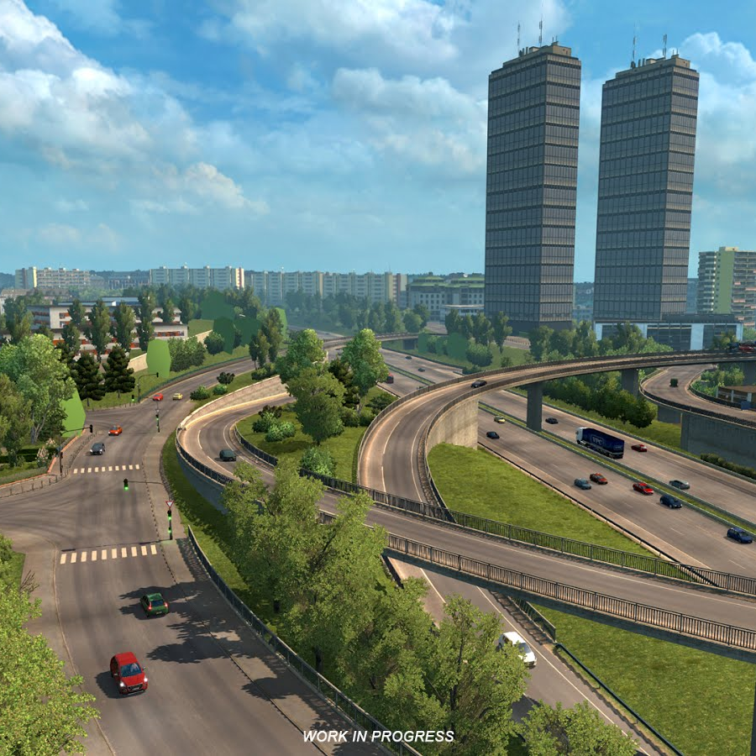
Without comprehensive funding, cities need to be purposeful about leveraging federal and state resources for downtown
Over-indexed on infrastructure, manufacturing, innovation, and climate policy
Downtowns
Housing
Manufacturing
Climate and Energy
Community Development
Innovation
Infrastructure
under-indexed on downtowns, housing, and community development

Slide 18
There are early policy signals from cities leveraging their distinctive downtown strengths through intentional investments and initiatives
Remaking Downtowns Physically
Diversify Downtowns Economically
Integrate Downtowns Culturally
Greater Detroit Downtown | Cuyahoga Riverfront Development in Cleveland | Infrastructure Investment in Fresno | Advanced Manufacturing Center in St. Louis | Procurement Playbook in San Antonio | Development of Sixers Arena in Philadelphia | Erie Downtown Development Corporation

Slide 19
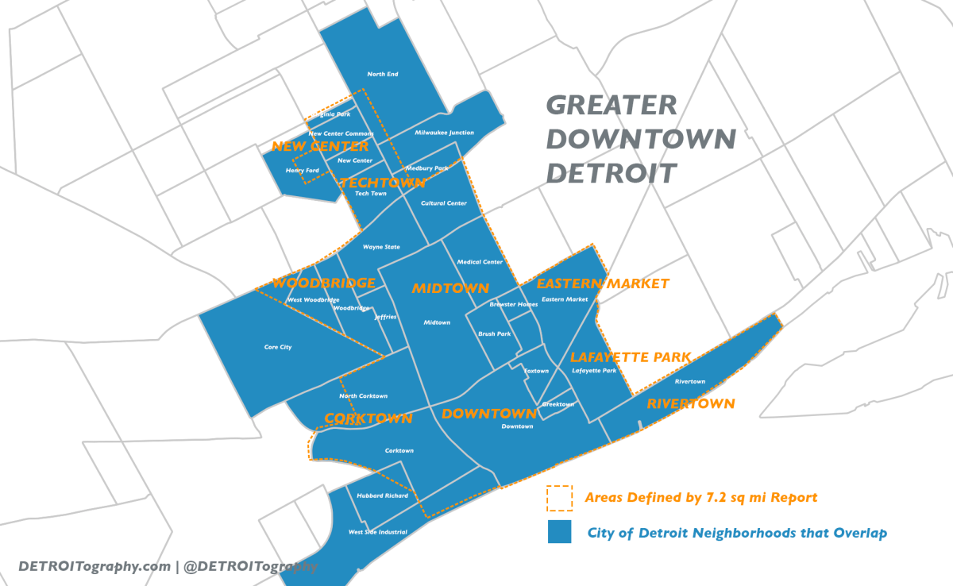
Early signals from across the country: Greater Detroit Downtown
Detroit is deploying five central strategies, which can be adapted and replicated by downtowns across the country:
Diversifying the economy through conversion of office towers, relocation of innovative assets, and linkage across auto and other tech sectors.
Unlocking the value of neglected parcels (The Monroe Street Midway) to amplify the character of place and engage residents.
Creating a new mixed-use, mixed-income, and equitably accessible hub along the Detroit Riverfront that’ll connect to downtown along a defunct rail line.
Embracing a proposed innovation district that already has committed tenants, such as the Michigan Israel Business Accelerator.
Demolishing Interstate 375 – a federally backed highway that bulldozed the neighborhoods of Black Bottom and Paradise Valley and divided the city – and converting it to a boulevard.
A group of leading corporations, developers, entrepreneurs, universities, philanthropies, health care institutions and local, state, and federal governments are -- separately and together -- designing, financing, and delivering the next downtown.
Notes:
Detroit -- Freeway demolition/street reconfiguration/new innovation district/residential conversions/
Look at World Economic Forum piece

Slide 20
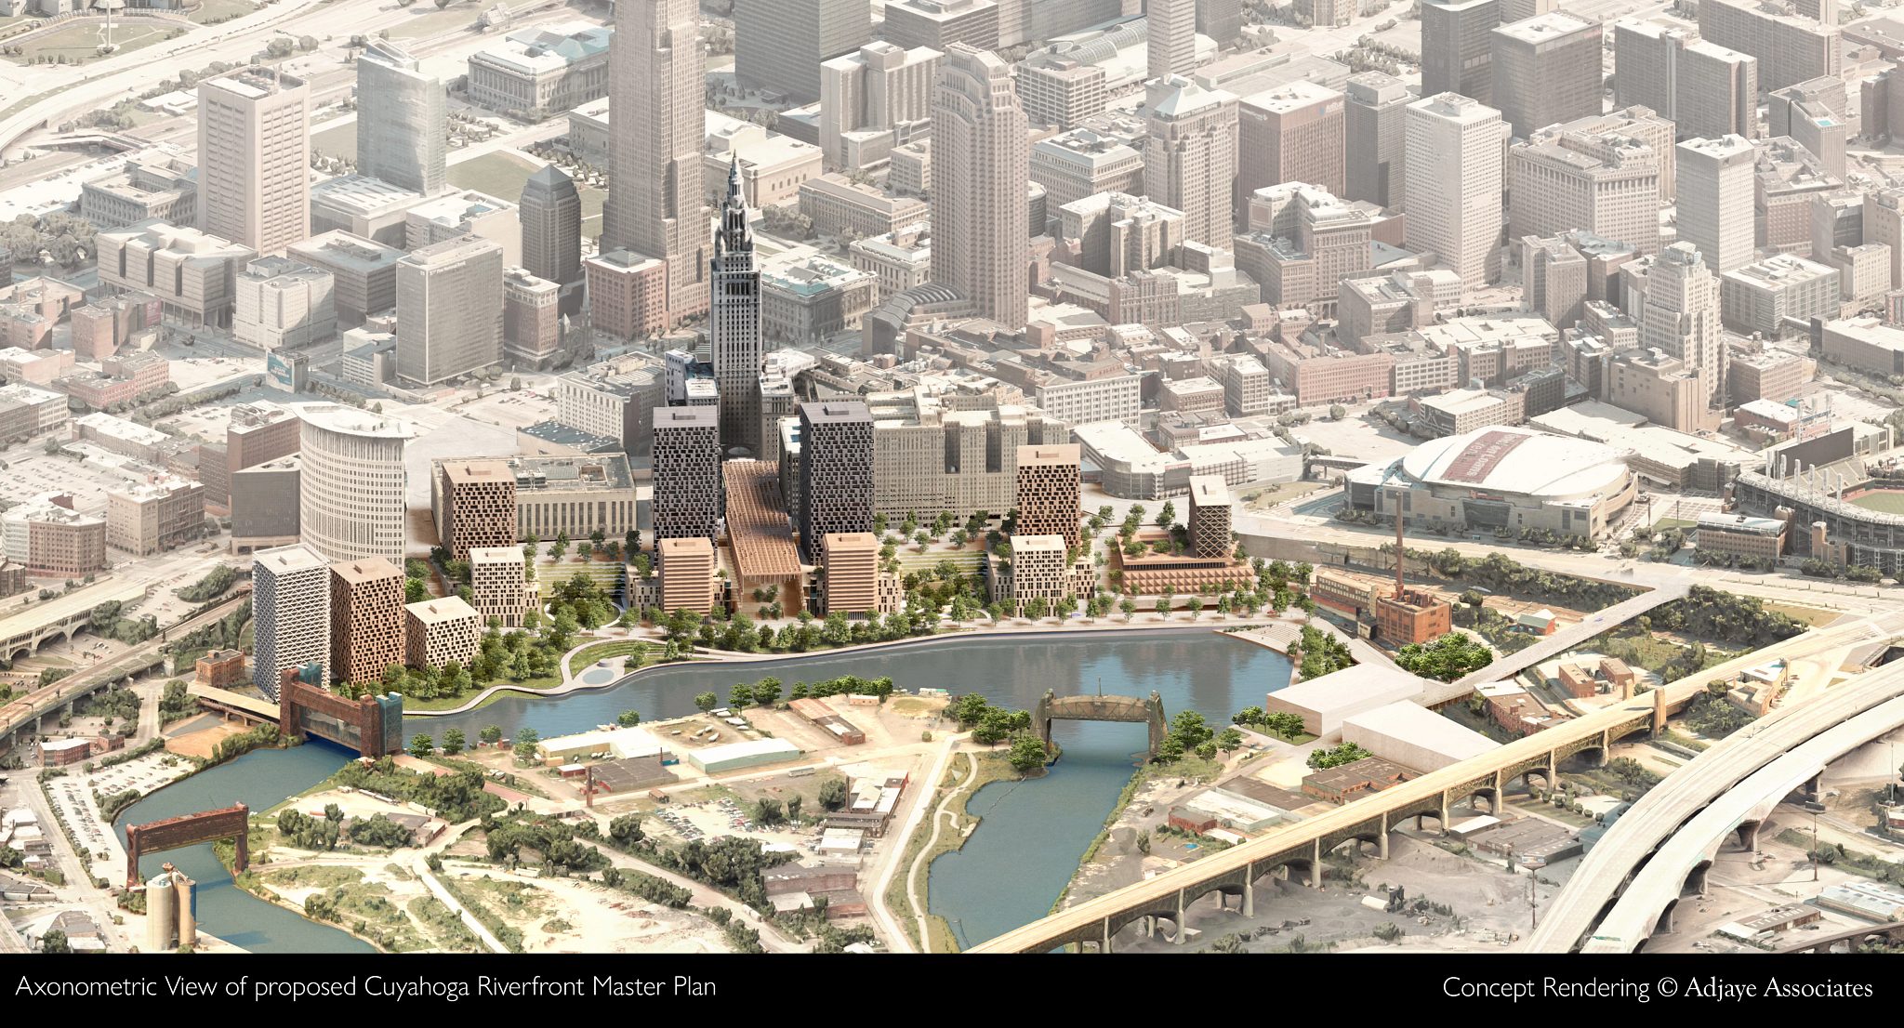
Early signals from across the country: Cuyahoga Riverfront Development in Cleveland
“Our redevelopment strategy for the downtown Cleveland Riverfront taps into the lost heritage of the city, establishing a new relationship between the urban core and the shore.”
-Sir David Adjaye
"It won't just be a national model, but a global model for how to create equity," he said at Friday's press conference, "in terms of master planning, and how to truly make sure our waterfront —and our riverfront—can be a model for the nation.”
-Mayor Justin Bibb
Source: New Localism Associates.

Slide 21
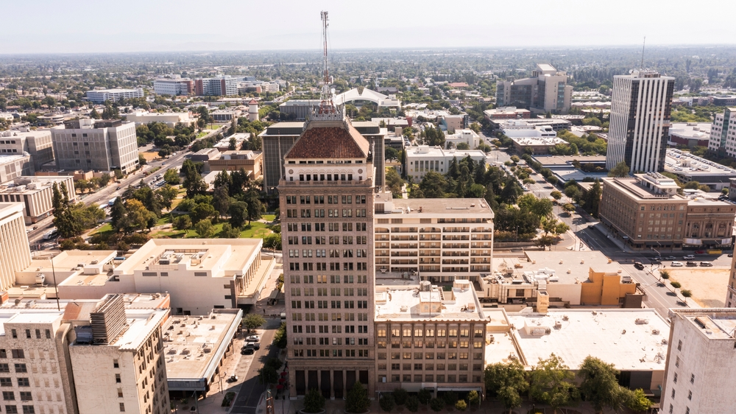
Early signals from across the country: Infrastructure Investment in Fresno
Fresno will receive $250M in infrastructure money from California. Some key highlights:
$70 million, would be used to provide two new parking structures in the downtown.
$80 million for overall infrastructure investments aimed at promoting the development of housing for 10,000 residents and revitalizing neighborhoods in downtown
$25 million for a stormwater drainage basin in the downtown area
“Far too long Fresno has been left behind, as has the Valley…This is the largest investment we will have ever received from state of California, and it’s all going into downtown Fresno”
-Mayor of Fresno, Jerry Dyer

Slide 22
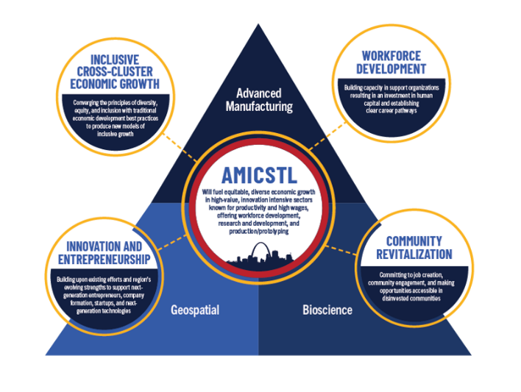
Early signals from across the country: Advanced Manufacturing Center in St. Louis
The St. Louis Tech Triangle, a corporate-created innovation district recently won $25M from the Build Back Better Regional Challenge to promote advanced manufacturing and build out the 130,000 square-foot Advanced Manufacturing Innovation Center.
Centers like these are emerging across the country to reshore production.

Slide 23
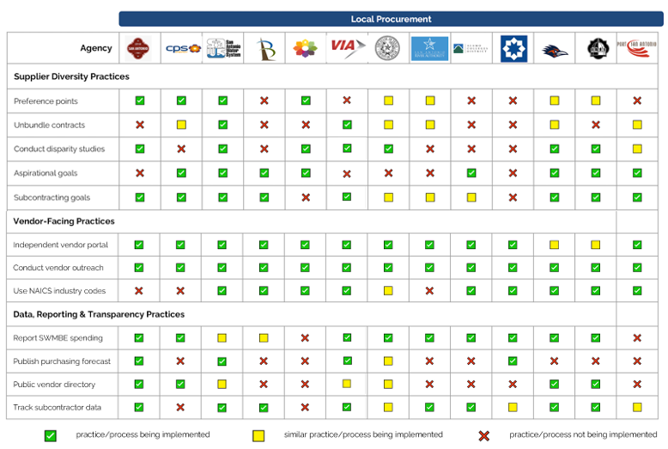
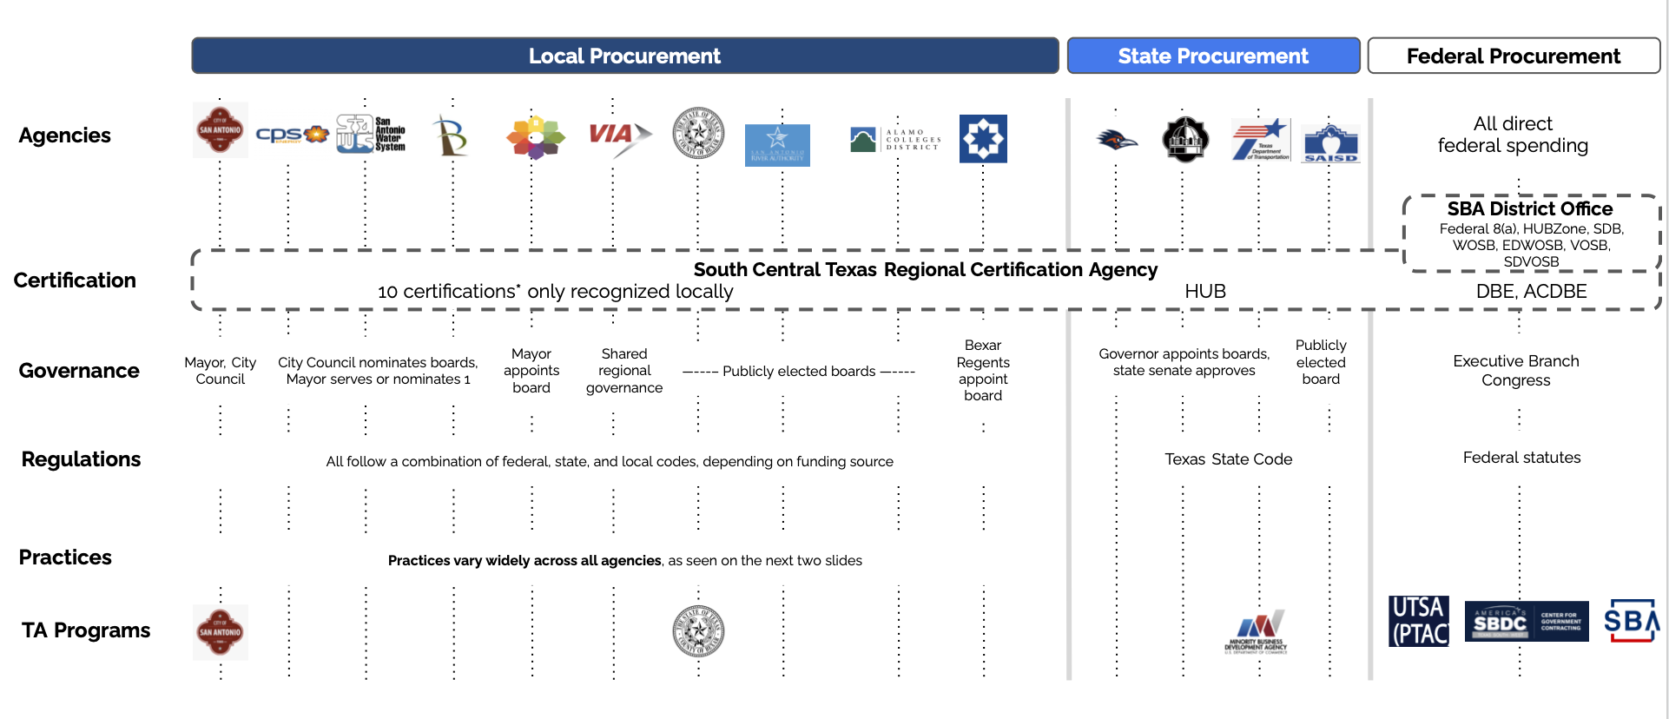
Early signals from across the country: Procurement Playbook in San Antonio
Public contracting is one vehicle through which minority-owned enterprises (MBEs) can grow their customer base and scale. We seek to identify user (firm) centric strategies that will support a stronger presence of MBEs in sectors ripe for contracting, maximize MBE participation in the entire public contracting ecosystem, and grow the number and size of B2G MBE firms in the U.S.

Slide 24
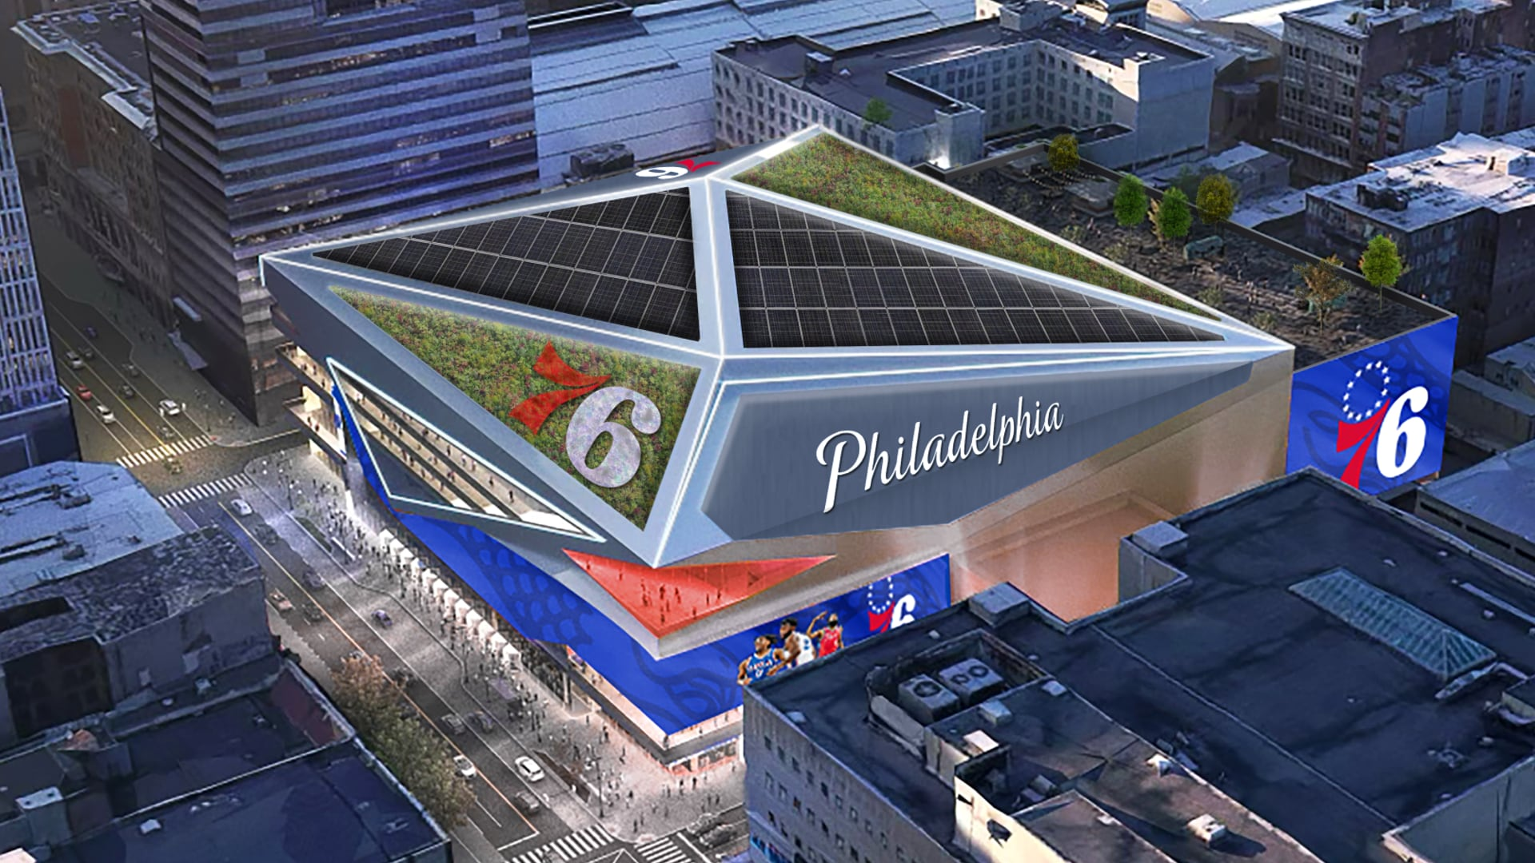
Early signals from across the country: Proposed 76ers Stadium in Philadelphia
The Sixers, after looking at potential sites for two years, recently announced the Fashion District of Philadelphia, as its proposed site for the 76s arena. This area has largely been neglected and was declining in foot traffic even before the pandemic.
The new arena would bring opportunity to stimulate activity and can draw on the site’s transit-rich location and potential to redevelop an existing commercial space.

Slide 25
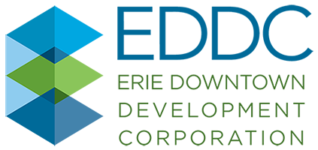
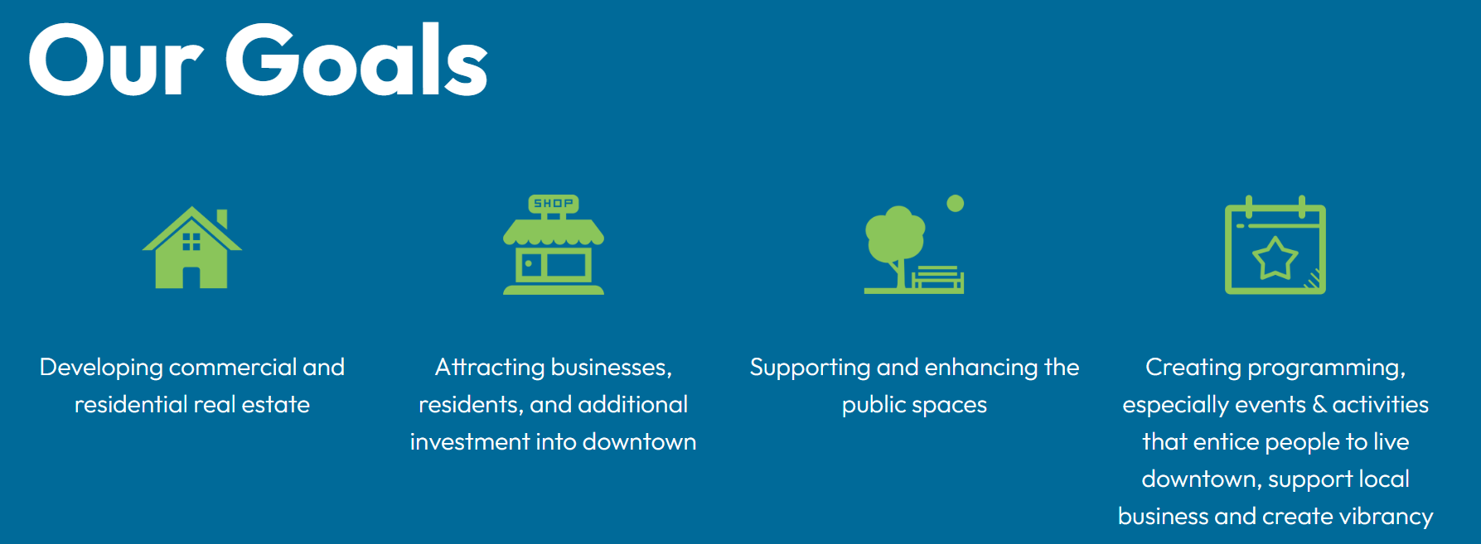
Early signals from across the country: Erie Downtown Development Corporation
EDDC formed in 2017 and brought together business, philanthropic and community leaders to transform the city of Erie’s downtown core and spark revitalization across the region. Institutions like this will be fundamental in organizing and strategizing downtown revitalization
Notes:
Detroit -- Freeway demolition/street reconfiguration/new innovation district/residential conversions/
Look at World Economic Forum piece

Slide 26
Contents
The Downtown Crisis
An Economy in Transition
Early Policy Signals
What Comes Next?
Notes:
This section should focus on the distributed nature of industrial production — which is a good thing

Slide 27
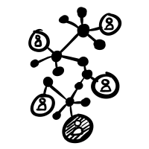
Cities need to adapt to these mega forces, understand their starting points and design and deliver strategies to maximize inclusive growth
Metros can:
Align federal investments with distinctive aspects of a community
Layer investments in same geography
Leverage private, public, and civic resources
Metros:
Have disproportionate economic impact
Are on the front lines of economic shifts
Have considerable spending power
Are Horizontally Integrated
Have Market Relevance
Metros
Metros can “think like systems and act like entrepreneurs”
-Matthew Taylor, former head of the Royal Society of Arts
"Power is shifting downward from national governments to cities and communities; horizontally from the public sector to networks of public, private and civic actors; and globally along circuits of capital, trade, and innovation.
New Localism is the twenty-first century’s means of solving the problems characteristic of modern life.”
-The New Localism, Bruce Katz and Jeremy Nowak
Have Networked Power
Metros have:
Multiple layers of power and authority
Bring together public, private, and civic leaders
Source: New Localism Associates.
Notes:
https://www.whitehouse.gov/briefing-room/statements-releases/2022/02/24/the-biden-harris-plan-to-revitalize-american-manufacturing-and-secure-critical-supply-chains-in-2022/

Slide 28
Cities need to deliver and design the next downtown
What’s your industrial edge?
Who is in your ecosystem?
What’s your infrastructure strategy?
What’s your residential strategy?
What’s your innovation play?
What's your small business opportunity?
What’s your workforce imperative?
Do you have the right institutions?

