Slide 1
Drexel University College of Medicine
Celebrating Our Early Black Physicians
National Medical Association’s
115th Annual Convention and Scientific Assembly

Slide 2
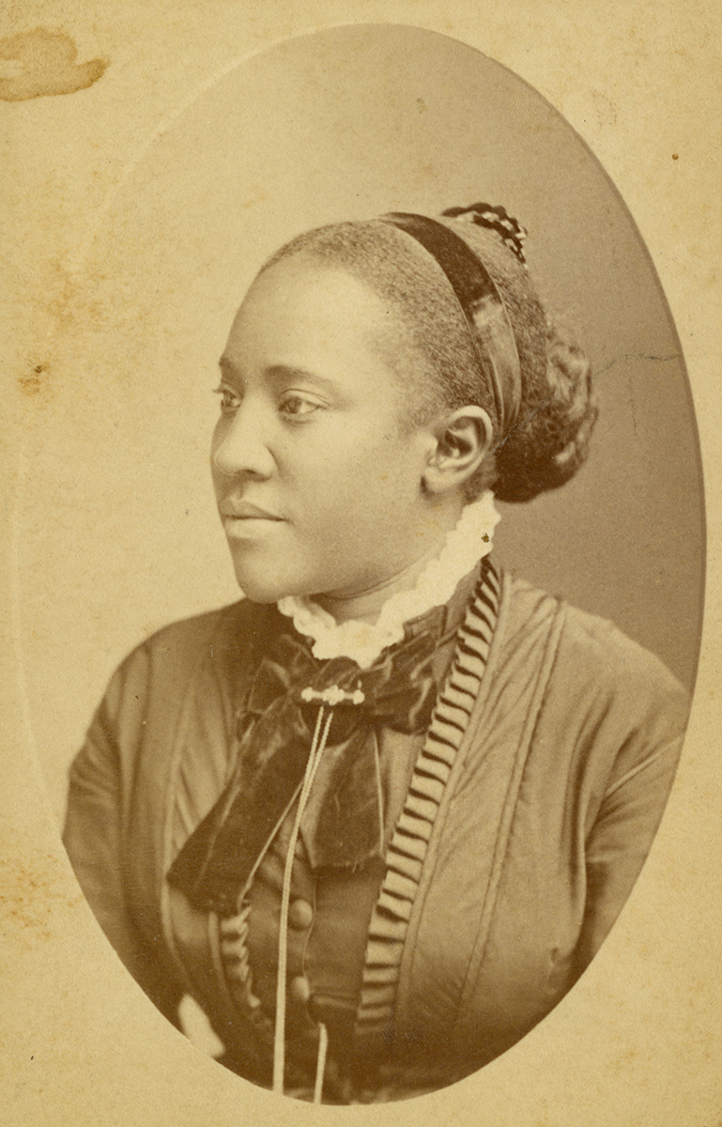
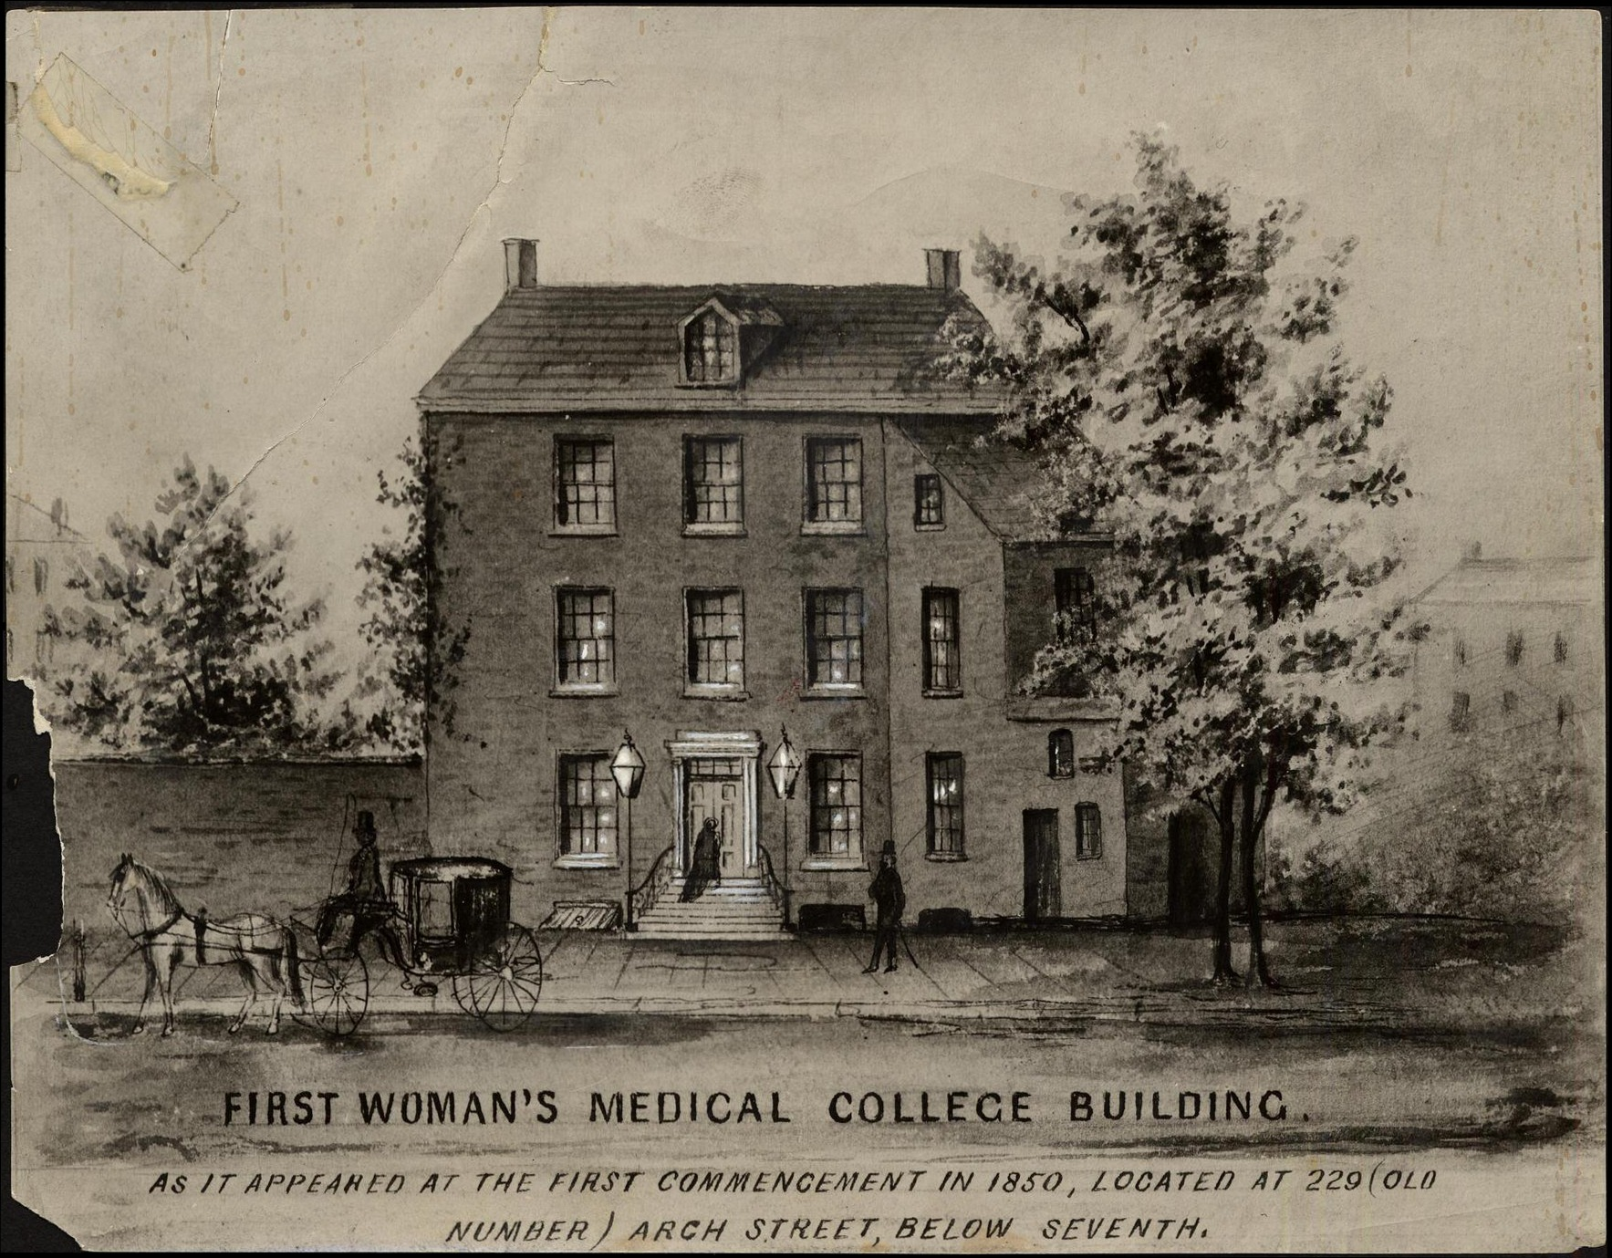
1867
Rebecca Cole
(Woman's Medical College)
1878
Caroline Still Wiley Anderson (Woman's Medical College)

Slide 3
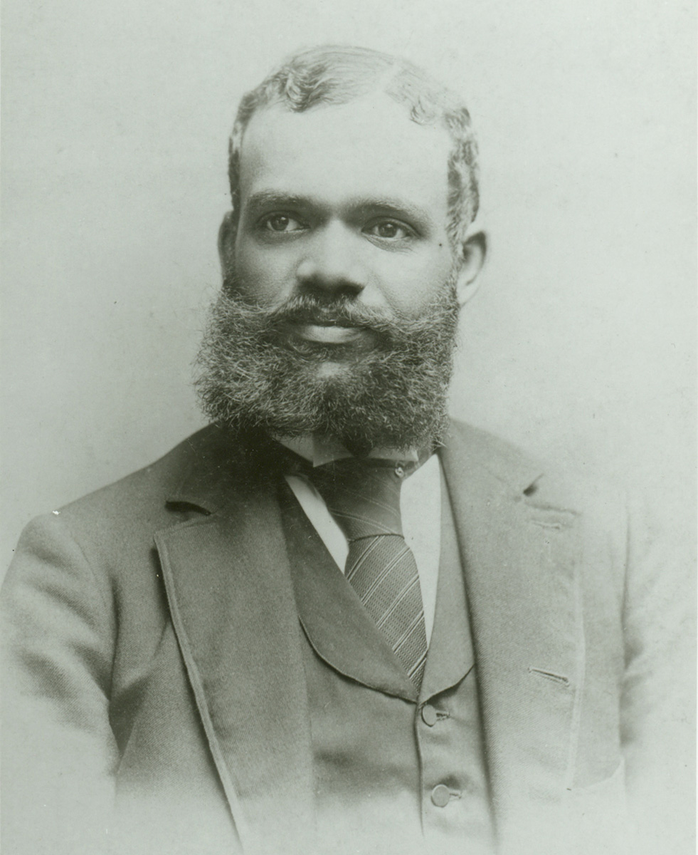
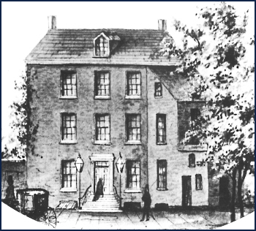
1878
Georgiana Patterson Young (Woman's Medical College)
1884
Thomas Creigh Imes
(Hahnemann Medical College)

Slide 4
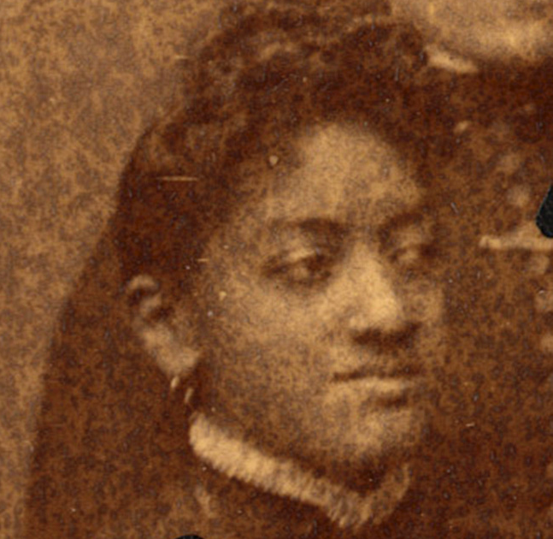
1888
Juan Bennet-Drummond (Woman's Medical College)

Slide 5
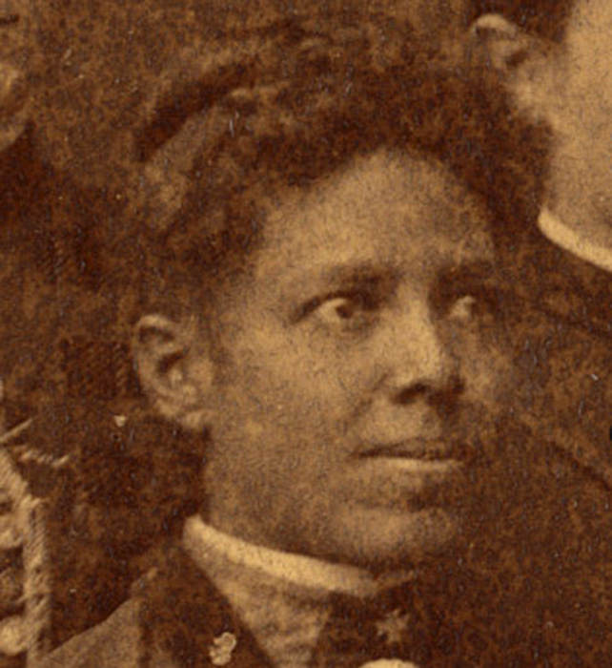
1888
Verina Harris Morton Jones (Woman's Medical College)

Slide 6
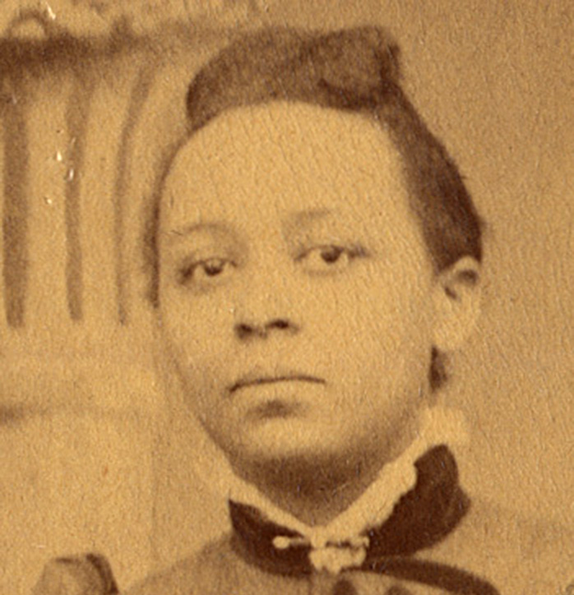
1891
Hallie Tanner Dillon Johnson (Woman's Medical College)

