Slide 1
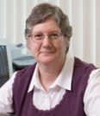
Yes You Can! How to Start from Scratch and Succeed at Assessment in One Year
Presenters:
Dr. Ruth Sandberg
Faculty Liaison for Academic Assessment
Dr. Rosalie Guzofsky
Dean and Vice President of Academic Affairs
Notes:
Title Slide – Will be on the screen as participants come into the room
Hello and welcome
Introduction of Ruth and Rosalie.
Move from Panic to Relax.
Handouts used during the presentation - not all the slides are in the Handouts. We will let you know which Handout to use as we go through the presentation.

Slide 2
Yes You Can!
Presentation Objectives
After this presentation, participants will be able to:
Create their own Templates for Assessment documentation
Create their own Perpetual Assessment Calendar
Notes:
We have two basic objectives in this presentation:
After this presentation, participants will be able to:
Create their own Templates for Assessment documentation
Create their own Perpetual Assessment Calendar

Slide 3
Yes You Can!
GO TO PAGE 2 IN THE HANDOUTS *
10 Basic Steps to Assessment
Notes:
Page 2 - There are 10 basic steps to Academic Assessment which we will review in this presentation:
1. Creating an Assessment Team
2. Creating Program Goals
3. Creating Course Learning Objectives and Aligning Objectives with Program Goals
4. Creating a Curriculum Map
5. Selecting Direct Measures for Assessment
6. Creating Rubrics
7. Creating Spreadsheets from the Rubrics
8. Analyzing Data from the Spreadsheets using a Benchmark
9. Writing a Program Assessment Report
10. Creating a Perpetual Assessment Calendar

Slide 4
Yes You Can!
Step #1
Creating an Assessment Team
Faculty
Dean or Administrative Authority
“Point Person”
Administrative Assistant
Notes:
Step #1 - Create an Assessment Team
Don’t tackle the entire assessment process alone - feel as though the weight of the whole world is on you.
Faculty members - bulk of the assessment work
Dean or Administrative Authority - to reinforce the assessment process
“Point Person” for the Team, such as a Faculty Liaison for Assessment
Administrative Assistant - follow up on deadlines, collect and organize all the assessment materials

Slide 5
Yes You Can!
Step #2
Creating Program Goals
Specific Skills and Knowledge
Tag Line
Action Verbs
Limit Goals
Notes:
Once Team in place, Step #2 - Creating Program Goals
Guidelines in creating Program Goals:
What skills or knowledge should students gain from the program; how will they gain those skills or knowledge
Use a tag line to introduce your goals:
“After completing this program, students will be able to…”
Use one action verb only for each goal, such as the following:
Analyze, Compare, Create, Differentiate, Evaluate, Formulate, Identify…
Limit the number of goals to no more than 5

Slide 6
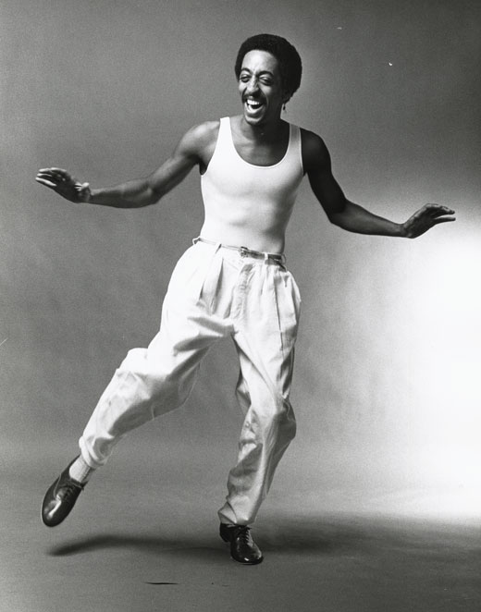
Yes You Can!
Notes:
To help you in process of creating program goals - example of program goals for an imaginary BA in Tap Dancing

Slide 7
Yes You Can!
* GO TO PAGE 3 IN THE HANDOUTS *
Notes:
Top of page 3 of handout:
Program Goals for a BA in Tap Dancing:
Upon completion of the BA in Tap Dancing, the graduate will demonstrate the ability to:
1. Critical Thinking - Evaluate the quality of a tap dance performance
2. Diversity - Describe the differing genres of tap dance and their ethnic variety
3. Information Literacy - Identify the basic literature and research on tap dance
4. Communication - Convey the basic principles of tap dance (dance steps, costumes, music) orally, in writing, and in performance
Goals follow the rules of: Specific Skills and Knowledge, Tag Line, Action Verbs, Limit Goals

Slide 8
Yes You Can!
PRACTICE
Notes:
Practice #1 – Bottom of Page 3
Want to give you some time during presentation to practice creating your own program goals
These goals are actually based on standard goals used in many undergraduate programs throughout the United States, so you should feel free to utilize them for creating your own program goals - which you are going to do NOW at the bottom of page 3.
Take some time at your table to discuss one or two program goals you would like to create for your program
If you already have program goals well established, share your goals with the other people at the table
Guidelines for creating program goals – also listed on page 3

Slide 9
Yes You Can!
Step #3
Creating Course Learning Objectives
Specific Skills and Knowledge
Tag Line
Action Verb
Limit Goals
Align with some Program Goals
Notes:
Step #3 - Creating Course Learning Objectives for individual courses in your program
Course Objectives - follow similar guidelines to those used for Program Goals, but more targeted for a specific subject:
What skills or knowledge should students gain from the course; how will they gain those skills or knowledge
Use a tag line to introduce your goals:
“After completing this course, students will be able to…”
Use one action verb only for each objective, such as the following:
Analyze, Compare, Create, Differentiate, Evaluate, Formulate, Identify…
Limit the number of objectives to no more than 5 – it is best to have no more than 3 course objectives, since the more you have, the more assessment work you will have to do
Align the course learning objectives with at least some of the program goals

Slide 10
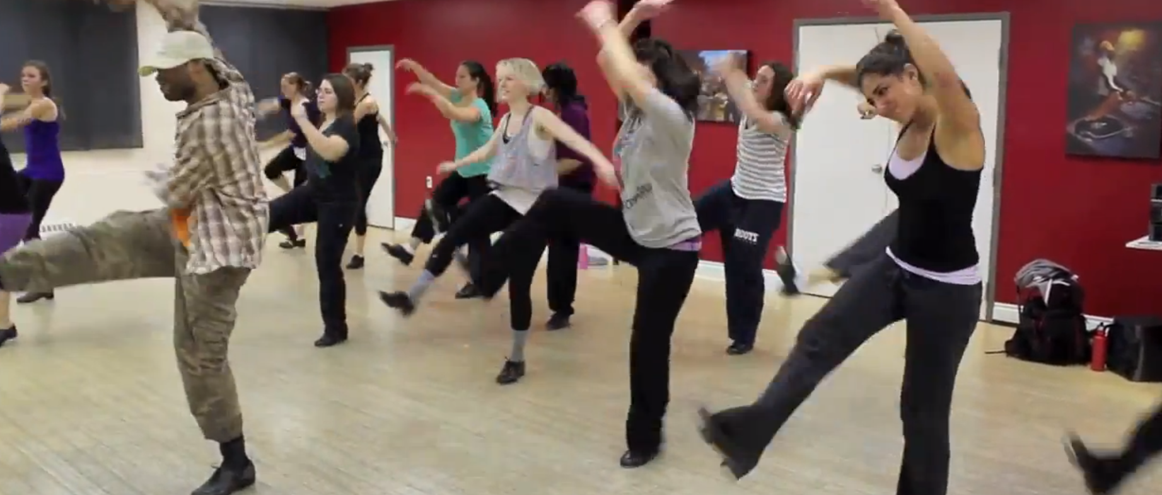
Yes You Can!
* GO TO PAGE 4 IN THE HANDOUTS *
Tap Dance Performance 101
Notes:
On TOP of page 4 – Course in Tap Dance Performance 101
Example - Course Learning Objectives for Tap Dance Performance 101
After completing the course in Tap Dance Performance 101, the student will be able to:
1. Demonstrate musical rhythm
2. Demonstrate knowledge of different types of tap dance steps
3. Wear an appropriate tap dance costume
Bottom of page 4 – you can create your own course learning objectives for a specific course at a later time

Slide 11
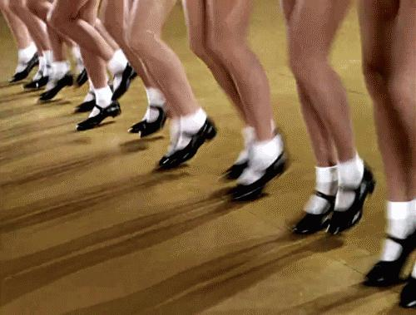
Yes You Can! PRACTICE Aligning Couse Objectives with Program Goals
* GO TO PAGE 5 IN THE HANDOUTS *
Notes:
Practice #2
As part of Step #3, you have to align your course learning objectives with the Program Goals
We will practice this next
Practice - TOP of Page 5 in your handout - Discuss at your table how the course objectives for Tap Dance Performance 101 align with the Program Goals
You may find that you have disagreements in this process, and that is perfectly normal!
Chart at bottom of Page 5 you can fill out later with your own course learning objectives and how they align with your Program Goals

Slide 12
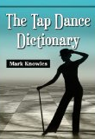
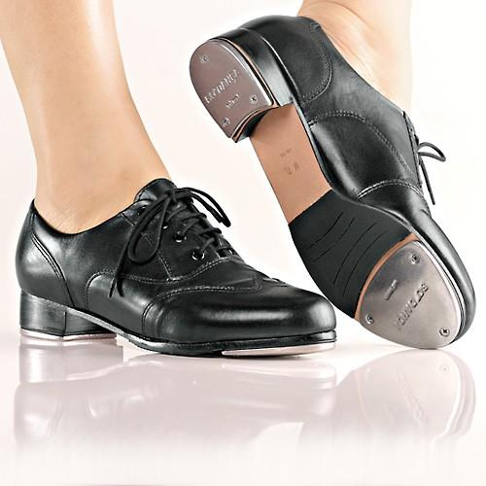
Yes You Can!
Creating Course Objectives for ALL the Courses in your Program
Fall Roster 2015
Tap Dance Performance 101
Tap Dance Costumes 102
Great Tap Dance Stars 103
Tap Dance Footwear 104
Tap Dance History and Terminology 105
Notes:
Keep in mind that you will have to create course objectives for all the courses in your program
Using our BA in tap dancing model –
In addition to Tap Dance Performance 101, program would conceivably have:
Tap Dance Costumes 102
Greatest Tap Dance Stars 103
Tap Dance Footwear 104
Tap Dance History and Terminology 105
All courses have to have course learning objectives that align with some of the Program Goals

Slide 13
Yes You Can!
Step #4
Creating a Curriculum Map
Notes:
After creating course objectives for all courses, move on to Step #4 - creating a Curriculum Map
Purpose of a Curriculum Map - to see if all your Program Goals are covered somewhere in the courses you offer in your program

Slide 14
Yes You Can!
Defining and Using the
I
R
E
Method
Introduces a Program Goal
Reinforces a Program Goal
Emphasizes a Program Goal
Notes:
I = Course introduces the concept of a program goal
• R = Course reinforces or contributes to opportunities for achieving a program goal
• E = Course emphasizes a program goal and promotes a level of mastery

Slide 15
Yes You Can!
* GO TO PAGE 6 IN THE HANDOUTS *
Notes:
Top of page 6 – Chart
List all the courses in your program in the left-hand column
Put an I, R, or E under each program goal
If the course only introduces a goal, put an I
If the course reinforces the goal, put an R
If the course emphasizes the goal, put an E
If the course does not involve a Program Goal in any way, leave it blank – BUT if a course in your program does not connect to your Program Goals in any way, you may want to consider eliminating the course or revising it.
Keep in mind that not all courses cover all goals - a course should NOT attempt to cover all the goals

Slide 16
Yes You Can!
PRACTICE
Creating a Curriculum Map
* PAGE 6 IN THE HANDOUTS *
Notes:
Practice #3 - Creating a Curriculum Map
Bottom of page 6 of your handout - discuss with your table how to fill out the Curriculum Map for the Tap Dancing courses listed
Use the I-R-E system for rating how you think each course covers a Program Goal
Again, this process is not cut-and-dried - faculty members have a lot of discussion and debate over how courses relate to the Program Goals and how to score them using the I-R-E method.

Slide 17
Yes You Can!
Selecting “E” Courses for Assessment
Notes:
Pretend that you and your Assessment Team have placed all the courses for the BA in Tap Dancing into a Curriculum Map
Assess ONLY courses that are “E” courses. You don’t need to assess every single course in your Program!
Courses that emphasize a particular Program Goal are logically the best ones to assess; often end up being required courses everyone takes

Slide 18
Yes You Can!
* GO TO PAGE 7 IN THE HANDOUTS *
Notes:
Page 7 - Course Tap Dance Performance 101 will be assessed, because it emphasizes Goal #4

Slide 19
Yes You Can!
Step #5
Selecting Direct Measures for Assessment
What are Direct Measures? Exam Quiz Short Essay Term Paper Portfolio Journaling Artistic/Musical Creation or Performance Class Presentation Online Forum Discussion
Notes:
Step #5 – Select Direct Measures for the “E” courses you are assessing
So, what are Direct Measures?
Direct Measures - activities or assignments students complete which can be objectively assessed
Exams and quizzes easiest to assess - you can easily find out objectively how well a student learned
Middle States prefers that we use direct measures - the most objective means of assessment and are the most reliable
I can have a vague idea about how much I think a particular student has learned, but until I have a direct way to measure that student’s level of learning, I can’t be certain.
Other direct measures of student learning are listed here…

Slide 20
Yes You Can!
* GO TO PAGE 8 IN THE HANDOUTS *
What are Direct Measures? Exam Quiz Short Essay Term Paper Portfolio Journaling Artistic/Musical Creation or Performance Class Presentation Online Forum Discussion
Notes:
Top of Page 8 - examples of Direct Measures used in Tap Dance Performance 101:
To assess goal #1 - Demonstrate musical rhythm - student has to perform a Tap Dance in time to music
To assess goal #2 - Demonstrate knowledge of different types of tap dance steps - student has to perform at least 5 tap dance steps
To assess goal #3 - Wear an appropriate tap dance costume - the student has to create a costume
The chart at the bottom of page 8 gives you an opportunity to create some direct measures for your own course learning objectives, which you can fill in later.

Slide 21
Yes You Can!
Step #6
Creating Rubrics – Quantifiable Data
Notes:
Step #6 - Professors can have a general sense of how well their students are doing - but to measure this objectively and with quantifiable data, need Rubrics along with Direct Measures.
Rubrics provide objective and quantifiable data to assess students’ work
Rubrics are charts which spell out what a student is expected to do, what constitutes excellent work, and work needing improvement

Slide 22
Yes You Can!
* GO TO PAGE 9 IN THE HANDOUTS *
Notes:
Top of Page 9 - Standard Rubric Template we use at Gratz College
We like to use a fairly basic Rubric that has no more than three elements - instructors find this type of Rubric easy to use and analyze
For assessment purposes the scale is: Mastery is 30 points, Proficiency is 20 points, and Needs Improvement is 10 points
You can use this Rubric Template for your own courses later

Slide 23
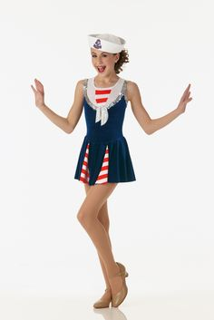
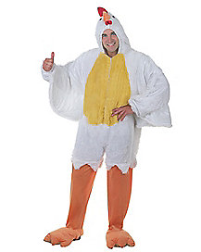
Yes You Can!
PRACTICE
* PAGE 9 IN THE HANDOUTS *
#3 Appropriateness of Costume for Sailor-Themed Tap Dance
#1 How well costume is made and fits
#2 Colorfulness of the Costume
Notes:
Practice #4 – Using an assessment scale
Page 9 at the bottom – Rubric for Creating a Tap Dance Costume.
Discuss at your table how to rate the three tap dance students on this slide based on the Rubric: Mastery, Proficiency, and Needs Improvement
Template at the top of Page 9 you can use later for your own courses.

Slide 24
Yes You Can!
* GO TO PAGE 10 IN THE HANDOUTS *
 | RUBRIC RESULTS
 | Element #1 | Element #2 | Element #3
Student 1
Student 2
Student 3
Student 4
Assessment Scale:
Mastery = 30 pts
Proficiency = 20 pts
Needs Improvement = 10 pts
Notes:
Top of Page 10
As your students submit their work, you’ll need to keep a record of how you assessed them. For this, we use a very simple Excel spreadsheet
Assessment not associated with students’ individual grades – assessment measures how well the students are learning as a whole, not what each individual student’s grades are
Grades are NOT a direct measure of assessment - they apply only to individual students can sometimes be rather subjective or arbitrary
Scale of 30-20-10 different from the normal 100% scale for grades

Slide 25
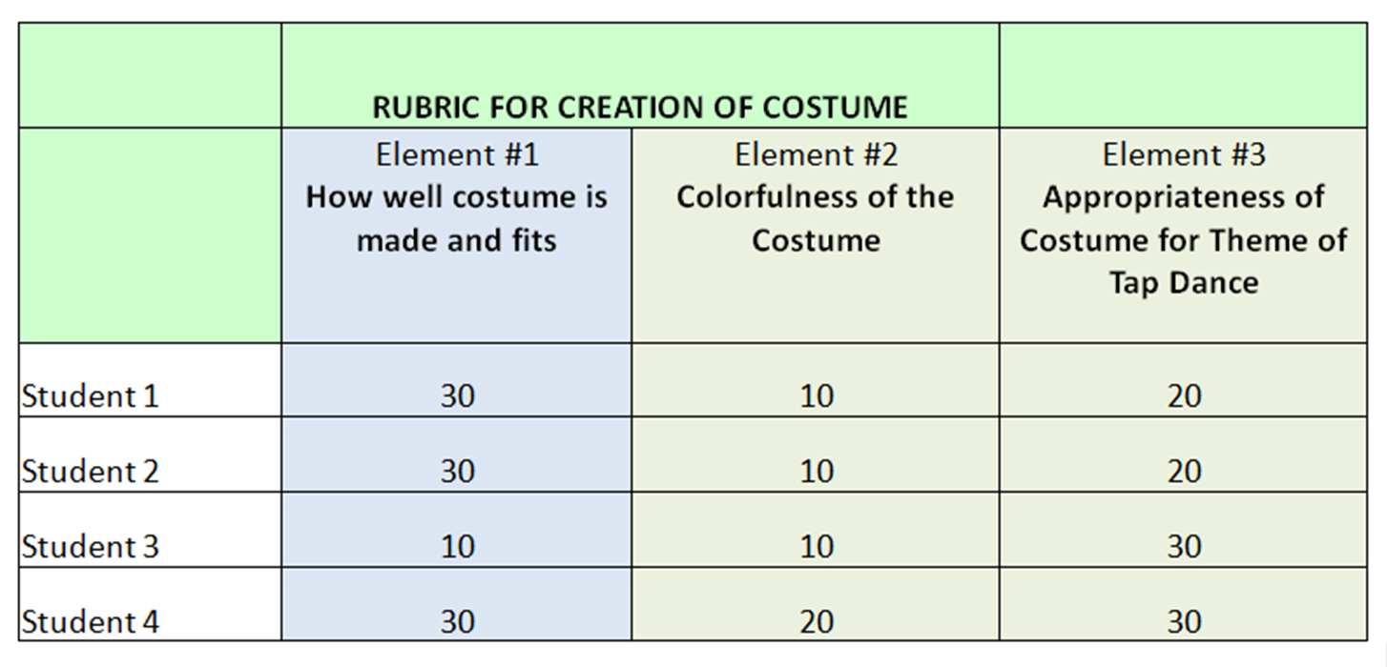
Yes You Can!
Filling in the Spreadsheet
* PAGE 10 IN THE HANDOUTS *
Mastery = 30 pts
Proficiency = 20 pts
Needs Improvement = 10 pts
Notes:
Bottom of Page 10
Sample of a completed Spreadsheet based on a Rubric for Creating a Costume – used assessment scale of 30, 20, 10
So now that the Spreadsheet is filled in, what do you do with the results? What exactly are you looking for in this Spreadsheet?

Slide 26
Yes You Can!
Establish a Benchmark
AT LEAST 70% OF THE STUDENTS
SHOULD BE AT THE PROFICIENCY LEVEL
Notes:
What you are looking for is a Benchmark.
We have a standard benchmark that we use in all our assessment Rubrics. Our current benchmark is that:
AT LEAST 70% OF THE STUDENTS SHOULD BE AT THE PROFICIENCY LEVEL.
For our purposes, let’s stick with this benchmark.
Main issue we need to address in evaluating data - whether or not at least 70% of the students reached Proficiency level

Slide 27
Yes You Can!
Step #8
Analyzing Data from the Spreadsheets
Notes:
Step #8 - Analyzing data that’s been collected on a Spreadsheet.
We will practice this

Slide 28
Yes You Can!
* GO TO PAGE 11 IN THE HANDOUTS *
PRACTICE
Notes:
Page 11
Practice #5 – At your table, analyze the data from the Spreadsheet to see what percentage of the students reached Proficiency or higher for each element of Creating a Costume

Slide 29
Yes You Can!
Improving Student Learning and Teaching
Element #1 = 75% * Element #2 = 25% * Element #3 = 100%
Notes:
75% of the students met the benchmark in Element #1, which is EXCELLENT!
100% of the students met the benchmark in Element #3, which is SUPER EXCELLENT!
Yikes! Only 25% of the students reached Proficiency in Element #2.
So, is this awful?
Have you failed as a teacher because no one reached Proficiency?
NO! In fact, this result is ALSO EXCELLENT, because you have uncovered an issue that needs to be addressed.
Congratulations!
THIS IS THE HEART OF ASSESSMENT, TO REALIZE WHERE STUDENT LEARNING AND TEACHING CAN BE IMPROVED!

Slide 30
Yes You Can!
Step #9
Creating a Program Assessment Report
Notes:
Step #9 - Creating a Program Assessment Report at the end of each semester or teaching session
Opportunity to review all the courses in your program and to see how well the program goals and course learning objectives were met
You do NOT need to assess every single program goal every teaching cycle!
It’s best to choose only one or two goals to assess for an entire academic year

Slide 31
Yes You Can!
* GO TO PAGE 12 IN THE HANDOUTS *
Notes:
Top of Page 12 - Program Assessment Report for the BA in Tap Dancing (Bottom of page has Template you can use later)
First column - we list the specific program goal being assessed
Second column - name of the course and Direct Measure used to assess goal
Third column - analysis from the Spreadsheet: For first element, 75% of the students reached Proficiency or higher; For second element, only 25% the students reached the benchmark; For the third element, 100% of the students reached proficiency or higher; Findings are really just a restatement of your Rubric and the Excel Spreadsheet analysis.
Now comes the most important part of Assessment! - Under Specific Recommendations, make Suggestions for improving student learning and teaching. Suggestion here - more time needs to be spent showing students the variety of colors available for costumes, and why a more colorful costume is desirable
Last column - discuss how and when the recommendation will be enacted. Syllabus will be changed the next time the course is taught
When you make a recommendation for a change in a course - NO GUARANTEE that the change will improve student learning
Assessment is simply our best effort or our best guess. We simply cross our fingers and hope for the best.
We only need to demonstrate that we are continually trying to improve student learning and teaching

Slide 32
Yes You Can!
Step #10
Creating a Perpetual Assessment Calendar
* GO TO PAGE 13 IN THE HANDOUTS *
Notes:
Step #10 – Creating a Perpetual Assessment Calendar that you can use every year, to help keep you on track for the ten basic steps of assessment
Every academic institution has its own schedule of when classes meet, so it’s not possible to use a standard Template.
Page 13 - Sample of an Assessment Calendar

Slide 33
Yes You Can! How to Start from Scratch and Succeed at Assessment in One Year
Notes:
If we can do it, so can you!
Yes You Can!
You Can Start from Scratch and Succeed at Assessment in One Year!
Thank you! Good luck!

