Slide 1

Evidence-Based Storytelling: Sharing our narratives
Natasha Jankowski, Ph.D.,
Associate Director
National Institute for Learning Outcomes Assessment (NILOA)

Slide 2
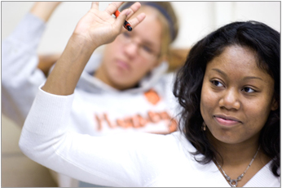

NILOA
NILOA’s mission is to discover and disseminate effective use of assessment data to strengthen undergraduate education and support institutions in their assessment efforts.
● Surveys ● Web Scans ● Case Studies ● Focus Groups
● Occasional Papers ● Website ● Resources ● Newsletter ● Presentations ● Transparency Framework ● Featured Websites ● Accreditation Resources ● Assessment Event Calendar ● Assessment News ● Measuring Quality Inventory ● Policy Analysis ● Environmental Scan ● Degree Qualifications Profile ● Tuning
  www.learningoutcomesassessment.org
Notes:
Our background and purpose, where located and when founded, what we do –a bit about NILOA

Slide 3
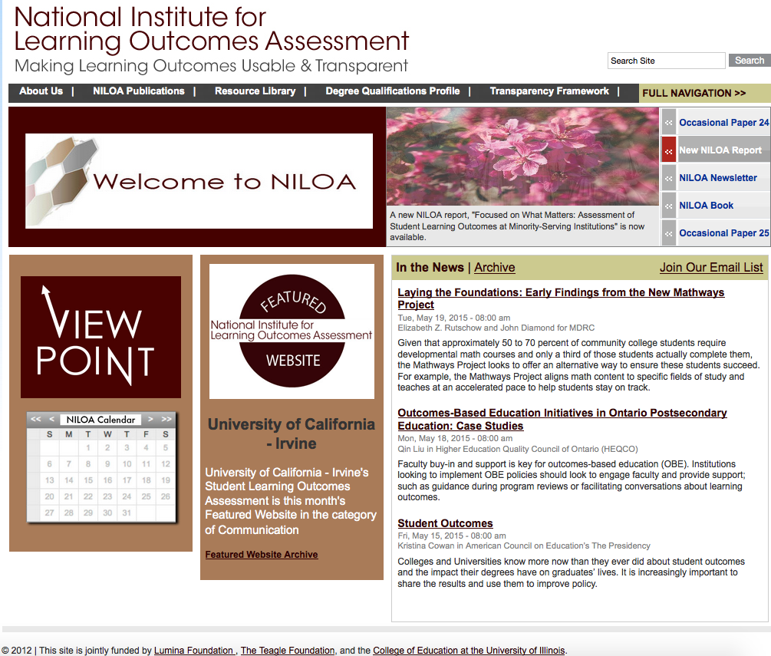

Slide 4
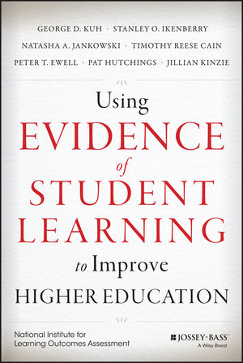
Notes:
Mention that pull work from the NILOA book on some of these points – obligatory slide

Slide 5


Using Assessment Results

Slide 6
Share
Anyone have examples of the use of assessment results they would like to share?
Where are you struggling on your campus?

Slide 7
Closing the Loop
Institutions have the greatest difficulty in the assessment cycle of “closing the loop” (Banta, 2009)
SLOs
Select
Measures
Gather data
Analyze the data
Use to improve
Notes:
Initiatives such as the Wabash study have emerged to help institutions use the data they collect to inform decisions and part of their findings was that it is not the case the there is a problem with the data – that institutions don’t have enough of it, or the right kinds of it, but that it is either not actionable – meaning that it is difficult to do anything with it, or that it is not clear what should be done if anything – there is an increasing awareness of the need for dialogue and meaning making of assessment results – a point I will return to shortly.
Trudy Banta and associates did case studies of institutions and found that only 12% were closing the loop
In our transparency research we found 24% of institutions were closing the loop

Slide 8

Using Results
Most assessment literature states that the reason or purpose of engaging with assessment in the first place is to USE the results to IMPROVE student learning (Banta, 2007; Ewell, 2010; Suskie, 2009; Walvoord, 2004)
But what does that really mean?
Notes:
So what does it mean to close the loop?
Well it means taking the results of assessment and then making changes within the institution that will lead to enhanced student learning…
But can that actually be done or known?

Slide 9
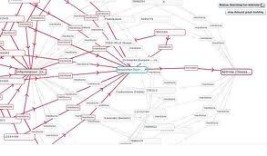
Causal Statements
The ability to make causal claims about our impact on students and their learning
Institutional structures and support + student = enhanced learning
Notes:
Mostly what we mean by closing the loop or using evidence of student learning to improve is causal in nature – we want to be able to make causal statements that our change in practice, behavior, course offerings, etc all lead directly to enhanced student learning
We are making causal claims about our impact on students
But this is hard to know

Slide 10
Difficulty of Causal Statements
Mobility of students
Untracked changes
Changes in courses add up to program level change
Levels at which use occurs
Longer than a year cycle
Loosely coupled relationships
Life
Notes:
Whole other issues of causality that are beyond the realm of considering because we can’t randomly assign students to courses, we can’t force faculty to teach exactly the same way and try out an intervention,
Issues of change management – most of these are related in some way to issues of change management and sometimes it is helpful to think of assessment from a change management perspective (loosely-coupled – org theory; or change management in organizations; systems thinking)
While this may seem messy, it is less messy and more complex. There are many moving parts, there is the co-curricular and the curricular, there is the life that happens as students are moving through institutions of higher education
Maybe what we need is a different way to think about it – a different way to tell or make the case that what we changed or did differently led to any increase in student learning – a different approach to get to impact or improvement

Slide 11
Theories of Change
Why do we think the changes we make will lead to better outcomes?
What is assumed in the changes we select as it relates to how students understand and navigate higher education?
Notes:
A good starting place is to engage in thinking about what is our theory of change – why is it that we believe that adding a course, changing the reading, increasing advising, adding a program, etc will have the desired impact of enhanced student learning?
What is the assumed mechanisms or levers of change?

Slide 12
Theory of Change (TOC)
A process of outlining causal pathways by specifying what is needed for goals to be achieved (Carman, 2012)
It requires articulating underlying assumptions which can be tested and measured (Jones, 2010)
A Theory of Change provides a roadmap outlining how one thinks or conceptualizes getting from point A to point B over time (Ployhart & Vandenburg, 2010)
Notes:
it changes the way of thinking about initiatives from what you are doing to what you want to achieve and starts there.

Slide 13
For instance…
Coverage and content
Opportunities and support
Intentional, coherent, aligned pathways
Within each of these is the belief about a root cause – why students were not learning or not meeting the outcome and the mechanism by which the institution can help them succeed
Notes:
I covered the content in my course, therefore my students learned it – if they didn’t learn it then I need to add an assignment or a course and cover it again
We provide all our students with opportunities and a writing center, support services, etc and we have now extended the hours and increased staff, and this will help students
Now you have the pathway and pipeline – so if we create intentional, coherent, aligned pathways it will help students to see what we want and how to get there and then they will learn more – it is also a mechanism that is structurally useful to being able to make stronger causal arguments because outcomes are aligned and mapped throughout the curriculum
But that is what we believe…how do we get others to agree that it is what we are doing and not something else that is leading to enhanced student learning – first we have to track student learning over time, but really what we need to do is tell our theory of change story – we need to be able to justify the changes that were made as something that we believed would enhance student learning

Slide 14
Root Cause
A process of exploring not only that something happened, but why it happened the way that it did (Rooney & Heuvel, 2004)
Moves beyond surface-level problem identification and examines assumptions in order to prevent reoccurrences (Taitz, Genn, Brooks, Ross, Ryan, Shumack, Burrell, & Kennedy, 2010)

Slide 15

Evidence-based storytelling
The story of the lonely students
Notes:
Also helps us share stories internally about what good assessment practice looks like for us, here

Slide 16
Your turn
Can you think of other stories you would like to share?
How often do you discuss assumptions about students and how and where they learn?

Slide 17
But…
Toulmin (2003)
Evidence Claim
Warrant
Warrants
Arguments
Notes:
Instead of outlining a theory of change, engaging in root cause analysis…we can think of warrant and arguments
What we are doing, is selecting a variety of evidence, which may change depending on the audience, and providing that in relation to a claim made about improvement of student learning. The warrant involves outlining and justifying why we think this change, for these students, at this institution, at this time, led to the improvement we are seeing in student learning. Or why we think it will.
What are we seeing in practice?

Slide 18
Evidence-based Storytelling
Evidence of student learning is used in support of claims or arguments about improvement and accountability told through stories to persuade a specific audience
(Jankowski, 2012)
Notes:
This is also a story to alert those on campus as to what good assessment practice looks like for this institution, what does use of student learning evidence look like here, what counts as evidence for decision-making here
Go over each bold piece briefly
It is a way to bring together improvement and accountability in a meaningful mechanism

Slide 19
Discussion and Reflection
Shared Meaning Making Across the Institution
70%
Examine multiple data points
Group data by theme not method

Slide 20
Sharing Practice
What does good assessment look like for us here?
Why do we think that what we are doing, for these students, will lead to enhanced learning, at this time?

Slide 21
The Brian Barton Story
A faculty chair in business examined the results of program outcomes for learners who completed the program capstone course and found that on one of the outcomes, learners were performing below what he regarded as the minimum threshold. Through the curriculum maps and alignments linking learning activities in individual courses to program outcomes in the capstone, he was able to identify across the entire program which courses had the strongest alignment to the outcome in question. From there, he was able to delve deeper into individual learning activities, to combine that information with additional data including course evaluations, and from the combined data to make detailed changes in specific courses and specific learning activities or assignments within courses. By the time participants in the revised courses and learning activities completed the capstone course, there was a measurable improvement in the particular outcome in question. The faculty chair involved in the process stated, “The concept of having an outcomes-based approach and having a strong theory of alignment all the way down to individual learning activities helps facilitate the use of assessment data.”
Notes:
A faculty chair in business examined the results of program outcomes for learners who completed
the program capstone course and found that on one of the outcomes, learners were performing below
what he regarded as the minimum threshold. Through the curriculum maps and alignments linking
learning activities in individual courses to program outcomes in the capstone, he was able to identify
across the entire program which courses had the strongest alignment to the outcome in question. From
there, he was able to delve deeper into individual learning activities, to combine that information with additional data including course evaluations, and from the combined data to make detailed changes in
specific courses and specific learning activities or assignments within courses. By the time participants
in the revised courses and learning activities completed the capstone course, there was a measurable
improvement in the particular outcome in question. The faculty chair involved in the process stated,
“The concept of having an outcomes-based approach and having a strong theory of alignment all the
way down to individual learning activities helps facilitate the use of assessment data.”

Slide 22
Veterinary Technology
Veterinary technology students did not score as well as needed in quantitative reasoning, for example, so veterinary technology faculty redesigned several key assignments to build and document that competency in students. Whereas previously students only read an article to learn about monitoring glucose levels in felines, the new assignment asked them to read the article, to take a reading of a cat’s glucose level, and then to use both sources to write an analytical report. This curriculum redesign created a more robust and discipline-specific quantitative reasoning experience for students and a richer set of documents to be collected and examined through ePortfolio. Addressing general education requirements throughout the program, according to the veterinary technology program director, means that “programs need to decide where they are addressing general education within the curriculum,” and using student artifacts collected through the ePortfolio “brings assessment to the forefront of the classroom.”
Notes:
Veterinary technology students did not score as well as needed in quantitative reasoning, for
example, so veterinary technology faculty redesigned several key assignments to build and document that
competency in students. Whereas previously students only read an article to learn about monitoring glucose
levels in felines, the new assignment asked them to read the article, to take a reading of a cat’s glucose level,
and then to use both sources to write an analytical report. This curriculum redesign created a more robust
and discipline-specific quantitative reasoning experience for students and a richer set of documents to be
collected and examined through ePortfolio. Addressing general education requirements throughout the
program, according to the veterinary technology program director, means that “programs need to decide
where they are addressing general education within the curriculum,” and using student artifacts collected
through the ePortfolio “brings assessment to the forefront of the classroom.”

Slide 23
Writing Across the Curriculum
The religion department wanted to know if their students were writing at a desired level, and so the faculty developed a writing rubric, gathered a random collection of student essays, and had a faculty panel rate them. A report was generated from the rating that outlined where students demonstrated or fell short on the outcomes in question. Areas where students fell short were used to refocus teaching and also to rethink the sequence of courses and assignments within courses so as to better reinforce the desired outcomes and help students improve. A faculty member involved in this effort remarked, “It seems so modest to state it now – we identified an intended learning outcome, made rubrics, looked at essays, and altered teaching – but that fairly modest process generated a holistic view of what students were doing well and what they were not doing so well, which allowed for minor adjustments. In a year or two these adjustments showed that students are doing better on a given outcome.”
Notes:
The religion department wanted to know if their students were writing at a desired level, and so the faculty developed
a writing rubric, gathered a random collection of student essays, and had a faculty panel rate them. A report was generated from the rating that outlined where students demonstrated or fell short on the outcomes in question. Areas where
students fell short were used to refocus teaching and also to rethink the sequence of courses and assignments within
courses so as to better reinforce the desired outcomes and help students improve. A faculty member involved in this
effort remarked,
It seems so modest to state it now – we identified an intended learning outcome, made rubrics, looked
at essays, and altered teaching – but that fairly modest process generated a holistic view of what students
were doing well and what they were not doing so well, which allowed for minor adjustments. In a year
or two these adjustments will show, I think, that students are doing better on a given outcome.

Slide 24
Assumptions
How do we think about our students? What assumptions do we make about them and their ability to learn?
Where do we think learning occurs?
What is our theory of change?
Why do we think the change we are proposing will lead to enhanced student learning?

Slide 25
Take Aways
There is not one “right” way to undertake assessment processes
Institutions consider what works, for their students, at this moment in time
Institutions develop shared understanding, through reflection and space for dialogue, what “good” assessment looks like within their specific institutional context

Slide 26
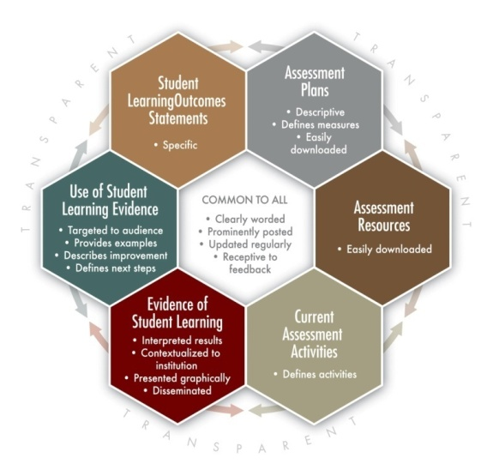
    If we engage in assessment for internal improvement, how do we share that externally for those interested in reports or compliance?
Notes:
Decline in need for faculty development against it still being a top concern perhaps = artifact of how we correlated these issues

Slide 27

Discussion
    Thank you!
    Email: njankow2@illinois.edu
    www.learningoutcomesassessment.org
www.assignmentlibrary.org
www.degreeprofile.org
Notes:
Decline in need for faculty development against it still being a top concern perhaps = artifact of how we correlated these issues

