Slide 1
Learning and Instructional Support Systems: Continuous Assessment in Context
D.L. McEachron
Drexel University, Philadelphia, PA, USA mceachdl@drexel.edu
M. Sualp
Untra Corporation, LLC, Philadelphia, PA, USA sualp@untra.com

Slide 2
Problem: Failure to Change
Instructional techniques in higher education have changed little
Current ‘Sage on the Stage’ model based upon mass information transfer approach
Does not adequately facilitate learning
Relies on information being controlled by institutions of higher education – no longer true in age of Internet
Homogenizes students – does not account for either diversity or change
Result – UnCollege movement
Can Higher Education Remain Relevant?

Slide 3
Reasons for Failure
Lack of faculty interest in educational innovations
A culture in higher education either passively or actively hostile to change
Faculty who teach mainly in isolation and thus have little or no opportunity to disseminate innovations through inter-personal contact
Limited resources at both a personal and institutional level which could be dedicated to improved teaching
A mismatch between innovations and faculty developed course goals
Inadequate information on the innovation, its underlying principles and historical context
Issues related to the return on investment (ROI) for the time and resources needed to implement an innovation
Poor design both of the innovation itself and the mode of dissemination

Slide 4
Recommendations
Match the educational innovation to the instructor’s learning goals
Educational innovations should be flexible and able to be adapted to local conditions
A means or method should be provided to experiment and reflect on the results of applying any innovation
To support such reflection, instructors should be provided with educational research and ideas as well as the finished product.
Innovation must be supported.

Slide 5
The Learning/Dissemination Model
Novelty generation;
Selection of Beneficial Novelties;
Promulgation and Diffusion of Novelties via a Social Network
B. Douthwaite, J.D.H. Keatinge, and J. Park, J. “Learning selection: An evolutionary model for understanding, implementing and evaluating participatory technology development.” Agricultural Systems, Vol. 72, 2002, pp. 109-131.
K. Sterelny. “Memes revisited.” British Journal of Philosophical Science, Vol. 57, 2006, pp. 145-165.

Slide 6
System Components and Overall Design
EduMemes Portal* where learning and instruction applications will be stored;
Instructional Decision Support System* (IDSS) which provides instructional applications in context to faculty instructors;
Guided Personalized Student Learning* (GPSLearning) system which provides learning applications in context to students;
SocraticNet, a web-based social network facilitating academic communication between faculty and students.

Slide 7
The Issues
Student
Current students have difficulty retaining critical information, knowledge and skill sets
Both horizontal (across courses) and vertical (across terms, years and sequences)
Require targeted review of specific materials
Different students require different reviews

Slide 8
Faculty Issues
Student cognitive retention issues limit advancement – reviewing materials in a 10-week term reduces new coverage
Rate of knowledge development hampers adoption of new pedagogies
Difficult enough to stay current in own field
New ideas/techniques in education often not tried or adopted
Emphasis on scholarly productivity as means of advancement limits other activities
Student course evaluations poor approach to instructor evaluation

Slide 9
Some Current Solutions
Existing Web-based materials
Advantages
Already available
Vast array of materials
Disadvantages
Not specific enough – often more materials than required
Not necessarily validated
Often not very sophisticated
Out of context

Slide 10
Potential Solution
EduMemes and EduMemes Portal
What is a meme ?
“A meme (/ˈmiːm/ meem)^{[1]} is "an idea, behavior, or style that spreads from person to person within a culture."^{[by whom?][2]} A meme acts as a unit for carrying cultural ideas, symbols, or practices that can be transmitted from one mind to another through writing, speech, gestures, rituals, or other imitable phenomena with a mimicked theme. Supporters of the concept regard memes as cultural analogues to genes in that they self-replicate, mutate, and respond to selective pressures.^{[3]}”
From: http://en.wikipedia.org/wiki/Meme

Slide 11
What is an EduMeme?
An EduMeme is defined as a modular learning object that can be used to enhance student learning and evolves in response to feedback
Two varieties (initially)
L-memes: modular tutorials, simulations and other educational applications that can be accessed by students in response to specific needs.
I-memes: These are modular applications that can be downloaded by instructors to provide access to innovative teaching methodologies and approaches, assessment tools and other applications that could be used by faculty instructors to enhance student learning.

Slide 12
Goal: The EduMemes Portal
Collection of validated L-memes and I-memes modular enough to be used by various students and instructors in a variety of circumstances and contexts and which evolve in response to user feedback

Slide 13
Evolutionary Model
Feedback Loops as Mechanism of Selection
Monitor Use and Disuse of Specific EduMemes as One Selection Pressure
Use Feedback as a Second Selection Pressure
More Successful EduMemes Increase in Promotion
Less Successful EduMemes Decrease in Promotion
EduMemes can be Modified and Resubmitted
Modified EduMemes then Enter Selection
Provides Adaptability Component
EduMemes continuously Evolve to Adjust to New Circumstances, Populations

Slide 14
EduMemes Portal - Example
Problem: During a lecture, an instructor wants to determine student understanding in order to pace or redirect the discussion
We have an EduMeme for that: Clickers
Main Features:
Contact information for several faculty with experience using clickers
One-page setup/implementation instruction set
Best use, potential pitfalls and suggestions
Directions to use collected data
Evaluation and usage data collection tools

Slide 15
Instructional Decision Support System (IDSS)

Slide 16
IDSS Format
Incoming
Student/Course
Profile (ISCP)
Incoming Student/Course Profile (ISCP)
Relevant student characteristics (learning styles, course load, work load, lifestyle, etc.)
Current performance – achievement on performance metrics related to the course materials
Suggestions for instructional approaches
Definitions of terms (what is meant by global or visual learning, etc.)
Links to possible instructional approaches for students with such characteristics through EduMemes Portal
Clear, simple format with links to additional information

Slide 17
IDSS Format
Course Rationale
and History
Profile (CRHP)
Course Rationale and History Profile (CRHP)
How does course fit into program curriculum?
What performance criteria and/or student learning outcomes are associated with the course
What educational experiences came before this class? What can students expect to encounter afterwards?
What is the value of the course?
How does learning this material and/or skill set facilitate program goals?
How does learning this material and/or skill set facilitate student goals?
Employment
Professional advancement

Slide 18
IDSS Format
Evaluation Results, Notes
and Recommendations
(ERNR)
Evaluation Results, Notes and Recommendations (ERNR)
Summarize assessment data for this course
Student/instructor observations/opinions/insights
Any direct measures of performance on previous students
Grouped data
Correlations with student characteristics and instructional approaches
Recommendations
Archival recommendations (searchable)
Current recommendations from latest assessment and evaluation

Slide 19
GPS-Learning
Learning Decision Support System for Students
Assumptions/Observations
Students use technology as learning tool
Students live in a world of mobile and ubiquitous computing
Students learn more effectively when they take responsibility for their own learning
Contextual Information
To fully exploit EduMemes learning elements, students must have information in context
The right information in the right place at the right time
Guided Personalized Student - Learning

Slide 20
Initial Element – Place Learning into Context of Program – DSLP Transcript
Drexel Student Learning Priorities (DSLPs)
Student learning goals and objectives to be realized by Drexel students and alumni as a result of a Drexel education
Example: Communication -
Employ an understanding of audience, purpose and context to communicate effectively in a range of situations using appropriate media

Slide 21
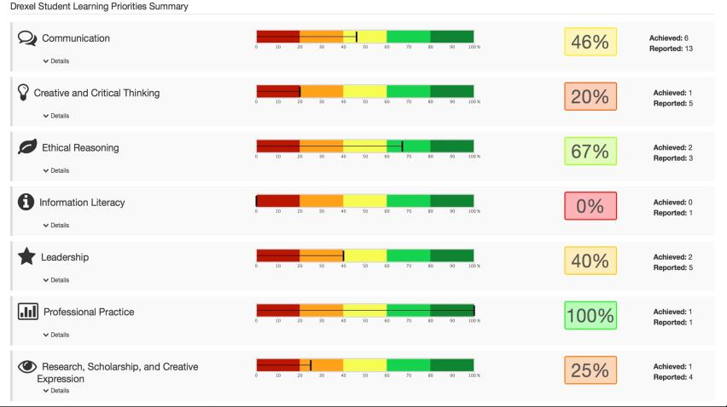
DSLP Transcript – Initial Mock-Up

Slide 22
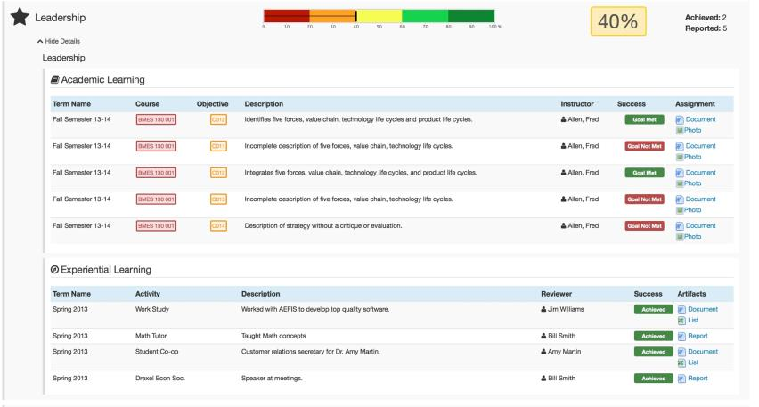
Data Mining

Slide 23
SocraticNet
Social network to link students, faculty and information system professionals
Multidimensional information flow
Instructor to instructor
Student to instructor
Instructor to student
Student to student
Electronic learning community
Inspired by Cloudworks*
*Conole, G. and Culver, J. (2010). The design of Cloudworks: Applying social networking practice to foster the exchange of learning and teaching ideas and designs. Computers & Education, 54(3): 679-692

Slide 24
Cloudworks
Initial Conditions
Including social features
Creating restricted categories (ex., pedagogy, tools and discipline)
Having a low barrier to entry
Including user profiles
Personal/private content blocked
Generating certain classes of communications, such as resources, tools and people & communities.
Networks evolves from initial conditions based upon user feedback
Implication – each network would evolve differently depending on initial conditions and feedback

Slide 25
SocraticNet
Similar initial conditions with some variations
User (instructor and/or student) profiles within the IDSS and GPS-Learning/DSLP Transcript dashboards.
EduMemes Portal will create classes of communication, such as when someone wants to access and download a specific learning or instructional element.
Interaction with libraries to enhance information flow

Slide 26
Comments/Questions?
Thank You!
Contact Information Dr. Donald L. McEachron
3141 Chestnut Street Philadelphia, PA 19104 Phone: 215-895-1382 Fax: 215-895-4983 Email: mceachdl@drexel.edu

