Slide 1
Drexel University Annual Conference on Teaching & Learning Assessment
Dr. Ed Guthrie
Dr. Bonnie Kirkpatrick
September, 2015
1-877-967-5464 | wilmu.edu

Slide 2
Session Objectives
Discuss 7 key elements that can be used to assess the needs of your institution
Identify the key elements in developing a plan for outcomes assessment
Demonstrate a roadmap for developing a program or college level OA plan
Assess the needs of your institution
or
Construct a sample plan
Discuss questions/concerns about the Assessment process
1-877-967-5464 | wilmu.edu

Slide 3
Getting Started with Outcomes Assessment
If you don't know where you are going, you might wind up someplace else." – Yogi Berra
Where are we? | Where are we going? | How are we getting there? | How do we know that we have arrived?
1-877-967-5464 | wilmu.edu
Notes:
Personal, institutional and program.

Slide 4
Institutions taking action to improve their assessment practices:
A Self-Assessment and Planning Tool (Handout)
The Fundamentals of Assessment
Assessment at the Course Level
Assessment Methods
Measures, Rubrics, and Tools for Assessing Student Learning Outcomes
Gathering Evidence
Assessment at the Program/Department Level
Assessment at the Institutional Level
1-877-967-5464 | wilmu.edu

Slide 5
So….. Now What?
Identify the Gaps
Your gaps become your goals
Match your goals with the appropriate elements
The Fundamentals of Assessment
Assessment at the Course Level
Assessment Methods
Measures, Rubrics, and Tools for Assessing Student Learning Outcomes
Gathering Evidence
Assessment at the Program/Department Level
Assessment at the Institutional Level
1-877-967-5464 | wilmu.edu

Slide 6
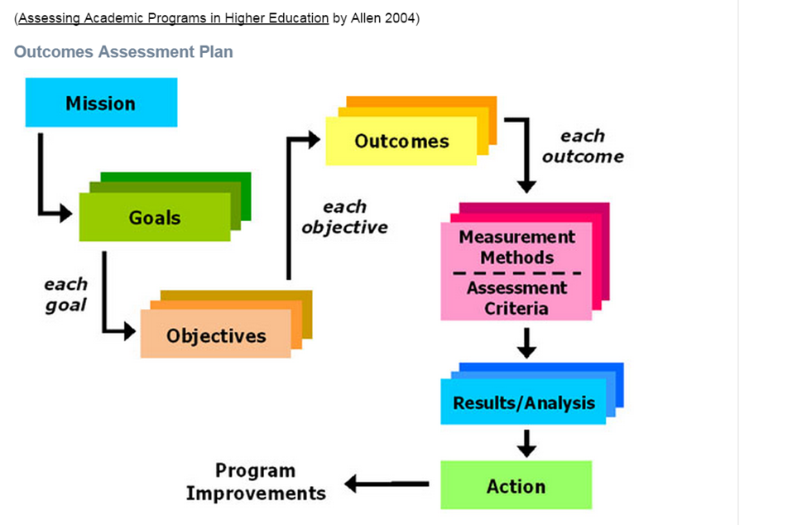
Outcomes Assessment Plan

Slide 7
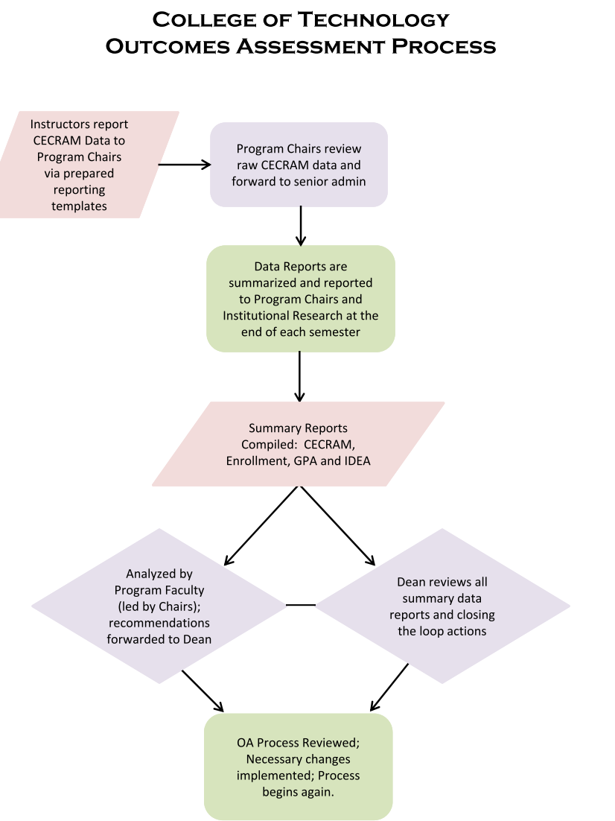
Process/Communication

Slide 8
Template for Outcomes Assessment Planning at the Program Level
Step 1-Map your curriculum
Mission:
Course Description | Course Goals (Where do we want to go) | Course Learning Objectives (How are we getting there?) | Course Learning Outcomes (How do we know that we have arrived?)
Student learning outcomes, should derive from the objectives which flow from the goals and mission of the program. An Assessment Plan includes all these components and focuses on the assessment of each learning outcome and how the evaluation of the results of the assessment are used for program improvement.
Source: assessment.uconn.edu/primer/components.html

Slide 9
Template for Outcomes Assessment Planning at the Program Level
Step 2- Check for alignment between the course description, the learning objectives, the learning outcomes and the measurement tool. Revise if needed.
Step 3- Review your learning objectives and your outcomes.
Ensure that your outcomes are written in measureable terms.
Ensure that your learning outcomes include/align with professional standards/licensing, certifications and program competencies
Mission:
Course Description | Course Goals (Where do we want to go) | Course Learning Objectives (How are we getting there?) | Course Learning Outcomes (How do we know that we have arrived?)
Alignment?
Measureable?

Slide 10
Outcomes Assessment Plan Matric
Step 4- Use the curriculum map to complete the Outcome Assessment Plan Matrix.
Outcome Assessment Plan Matrix
Program Mission:
Program Outcomes (intended learning outcomes of the program) Consider professional standards/licensing, certifications, program and graduation competencies | Relevant Experiences (courses, practica, internships, labs, etc. that support the outcome. | Activity (project, presentation, paper, exam, etc.) | Measurement (rubric, criteria, exam score, portfolio score, etc.) | Benchmark | Selected as an OA course (yes/no) (For OA purposes, you do not need to collect data on every course) | If selected as an OA course, list assessment frequency
Step 5-Determine which courses and activities will be used for the purpose of OA (you do not need to assess every course and every outcome at one time).

Slide 11
Data Collection
Step 6-Determine data collection process. Who, What, Where and When
Step 7- Collect and analyze the results
Data Collection Template
Selected OA course | Selected Activity | Selected form of measurement | Benchmark (target) | Assessment date | Summary of Results | Action-Based on the results, what changes will you make and when. | Stakeholders who need to be informed about the changes/who will be implementing the changes | Close the loop What occurred as a result of the changes and how do you know?

Slide 12
-Assess the needs of your institution/program -Start small -Maintain modest goals -Keep it manageable -Remind yourself that it is a process-and will continue to evolve over time -Plan your work and work your plan -Document your work -Exhaust your resources National Institute for Learning Outcomes Assessment
Where do you go from here?
1-877-967-5464 | wilmu.edu

