Slide 1
Assessing Your Creativity
Fredricka Reisman
Larry Keiser
Obinna Otti
©Slides Fredricka Reisman 9-1-2014

Slide 2
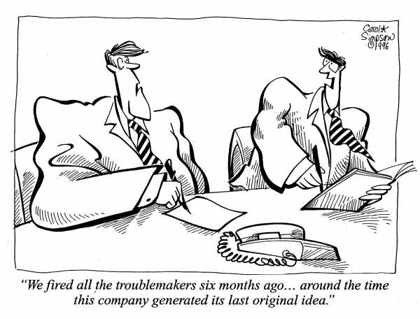
Originality
Presents unique and novel ideas associations of ideas

Slide 3
The Originality Scale
Idea by Marty Neumeier
New to Me New to World
Imagination
Adapted from Adapted from
Same Domain Different Domain
Knowledge

Slide 4
K x I = O
Knowledge
times Imagination
equals ORIGINALITY

Slide 5
Practice Originality
Random Words
(1) Find a random word that will be used as a stimulus for new ideas by looking around your environment and see what words are triggered.
(2) Find associations that involve relating the random word to other concepts. Continue generating associations until a creative topic emerges.
(3) Use the associations to create new ideas by linking any of the associations with your challenge.
Steps 2 and 3 may work together by finding an association and an immediate idea from it, thus pushing you to think in new ways and create novel ideas.

Slide 6
An original idea.
That can't be too hard.
The library must be full of them.

Slide 7
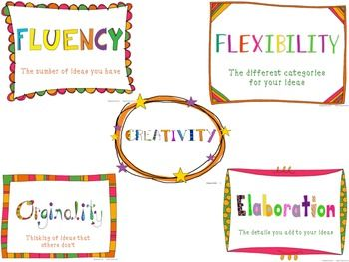

Slide 8
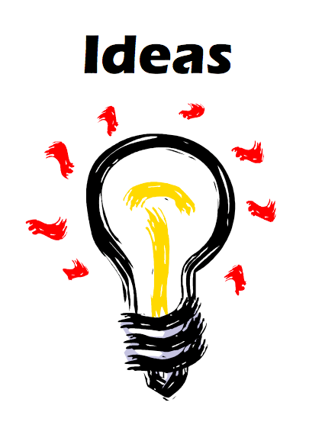
Fluency
Generates Many Ideas

Slide 9
Practice Fluency
List all of the words you can think of that begin with a certain letter, certain two letters, certain three letters, etc.
List all of the synonyms/antonyms you can thing of for a certain word.
Name uses for a bale of hay or a needle or a broom.
What are all of the uses (conventional or nonconventional) you can think of for a fork?
List as many equations as you can where the answer is 6. (3 + 3, 2 x 3, 26 – 20, etc.)
List all the possible settings for a scary story.
Source: Prufrock Press. Carol Fertig --file:///Users/reismafk/Desktop/PPt/%20Fluency%20to%20Stimulate%20Creativity.html

Slide 10
Practice Flexibility
Generates many categories of ideas, involves the ability to switch from one perspective to another
ex: Avoid generating letters of alphabet ( eg., A B D E,…) on TTCT parallel lines task.

Slide 11

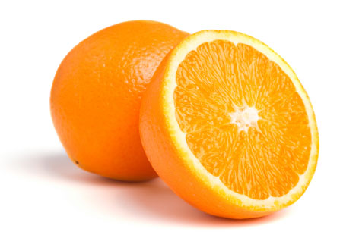
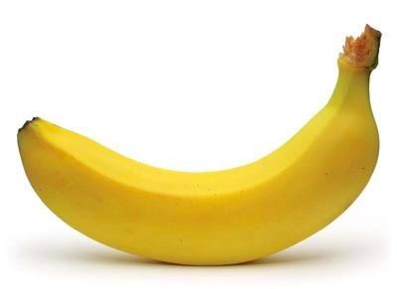
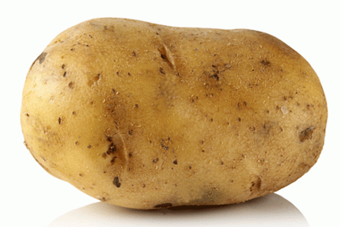

“How are they alike” enhances flexibility, generating many categories
water,
air

Slide 12
Elaboration
Adding detail to writing or drawing

Slide 13
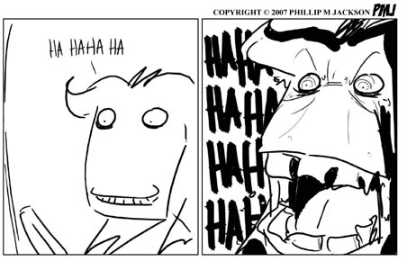
Practice Elaboration

Slide 14
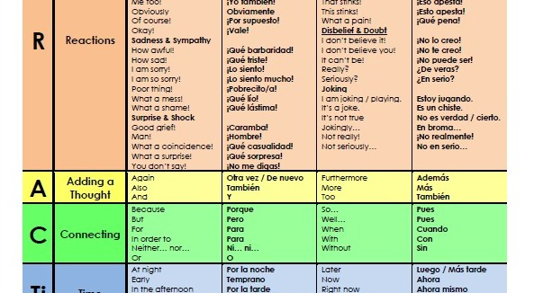
Elaboration Aid

Slide 15
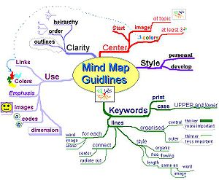
Practice Elaboration

Slide 16

Tolerates Ambiguity
Comfortable
with the
unknown

Slide 17
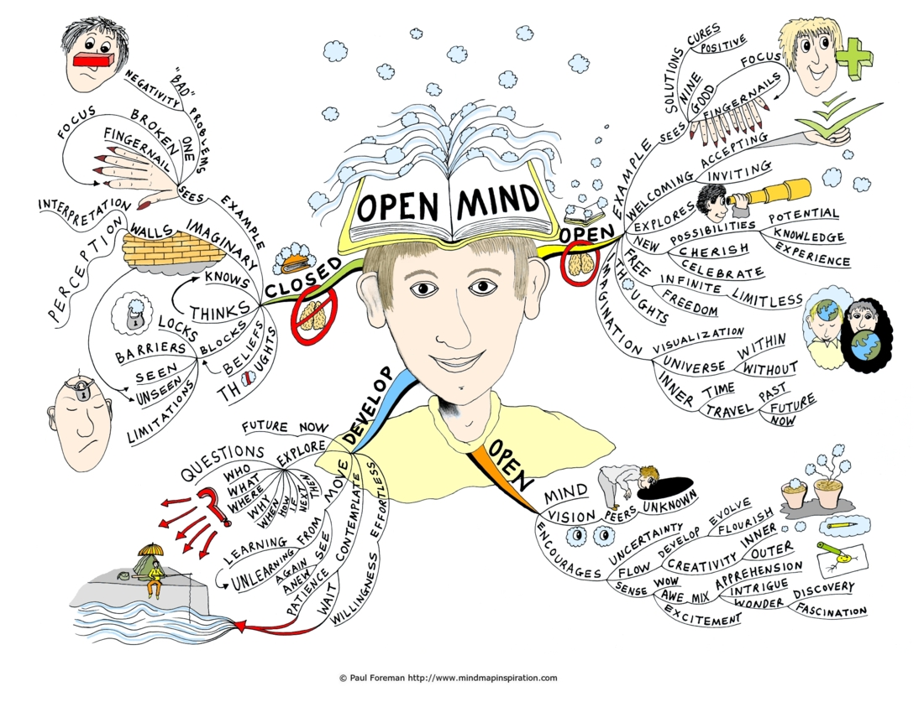
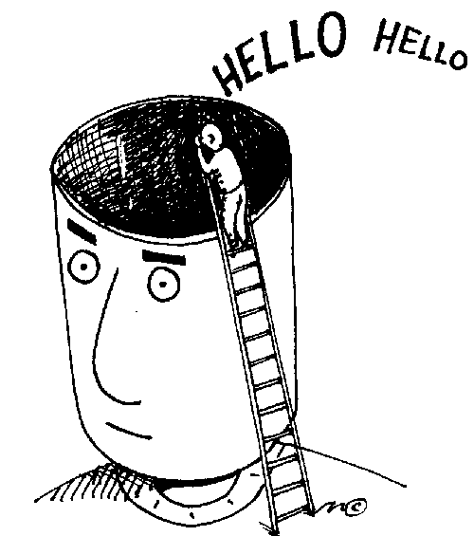
Resistance to Premature Closure keep an open mind

Slide 18

Smart Risk Taking - Venturesome, daring, exploratory

Slide 19
Practice Risk Taking
Challenging Conventional Wisdom
The deliberate questioning of existing paradigms and a willingness to take risks to buck the tide of popular opinion.

Slide 20
Practice Risk Taking
What is a risk? People should be clear about the term risk and what an actual risk is; namely, to try something without clearly knowing the final outcome.
Key Questions
• Are risks a good or a bad thing?
• Give examples where taking a risk has been a good thing to do.
• Give examples where taking a risk has been a bad thing to do.
• Describe when you have been forced to take a risk when you didn’t want to.
• Has anyone been forced to take a risk to help yourself or someone else.

Slide 21
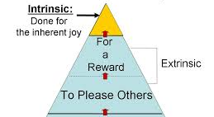
Motivation

Slide 22
Practice Motivation
Task-oriented
These people are largely motivated by the work they do. They like to get their heads down and develop great product, beat sales targets and so on.
In teams, they interact relatively little with others and succeed best when given jobs which they are work largely by themselves.
Self-oriented
These are primarily motivated by personal success and recognition. They are interested in work primarily as a means of achieving their own goals.
In teams, they need to be managed carefully. With suitable praise and reward they will flourish. There is also a risk that they will grab the glory from others and otherwise poison a harmonious working climate.
Interaction-oriented
These people are socially motivated and enjoy working with other people. They make good team-players and work best when engaged in collaborative work. They may also succeed in support positions where they help others to achieve goals.
Source: Bass and Dunteman (1963)

Slide 23
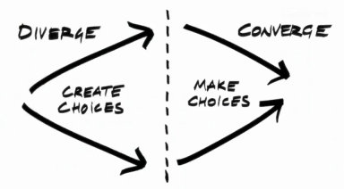
Convergent Thinking
Analyzes, evaluates, comes to closure

Slide 24
Creative problem Solving Process
©Tanner & Reisman (2014).

Slide 25
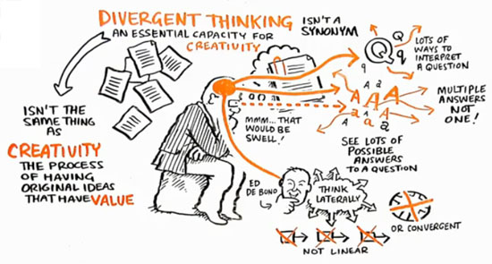
Divergent Thinking
Brainstorming

Slide 26
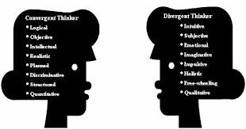
Convergent-Divergent Thinking

Slide 27

What’s Wrong?

Slide 28
Creativity is generating original, useful ideas. Innovation is implementing these ideas.
Ideas Strategies Vision Decision
Creativity
Innovation Goal

Slide 29
Drexel Creates Mobile Phone App to Assess Creativity
A new mobile phone application, offered on iTunes, was created by Dr. Fredricka Reisman under the technological direction of Cory Schmitt and Obinna Otti. The Reisman Diagnostic Creativity Assessment (RDCA) assesses an individual’s self-perception on 11 major creativity factors.
The new application is built upon the Torrance Tests of Creative Thinking (TTCT); however, the TTCT must be scored by trained evaluators and takes an hour or longer while the RDCA is automatically scored, takes about 10 minutes to complete and provides immediate results.

Slide 30
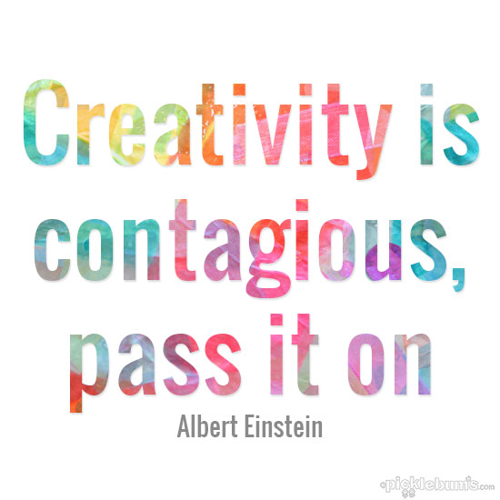
Questions? Comments?

