Slide 1
Assessment in the Evaluation of Teaching: Finding Balance
Sonia Gonsalves Susan Davenport

Slide 2
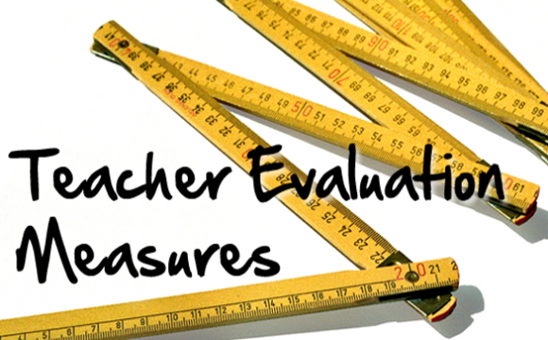

Slide 3
Quality Teaching – Outcomes Perspective
Facilitates meaningful learning
Measures of learning
Student report of learning

Slide 4
Quality Teaching – Process Perspective
Creates community
Giver of formative feedback
Organized
Prepared
Engaging
Adds value
Responsive
Masters subject matter
Good communicator
Fair

Slide 5
Quality Teaching – Philosophical
Reflective practice
Intentional
Rigorous
Sets high expectations
Learning - centered
Respects students

Slide 6
How directly is the evaluation
of good teaching
related to the definition
of good teaching?

Slide 7
A good teaching rubric?

Slide 8
Qualitative evaluation of teaching
Maximum performance
Peer review
Students’ comments
Letters of support
Endorsements from past students

Slide 9
Strengths and Limitations
Contextual
Professional judgment (peer)
Narrative & explanatory
Learning-goal related review
Limited sampling of teaching performances
Bias or peer pressure
Lack of clarity about the way in which peer evaluations are used

Slide 10
Quantitative evaluation
Typical performance
Student rating of instruction and teaching
The instruments
Important variables from research

Slide 11
Pros and Cons
Research on validity
Sampling – could be broad
Extensive sampling over many courses
Proper use
Sampling – could be skewed
Perceived vulnerability of pre-tenure faculty
Halo/horns
Course related features

Slide 12
Evaluation of products
Syllabus
Student work
Contribution to the scholarship
of teaching

Slide 13
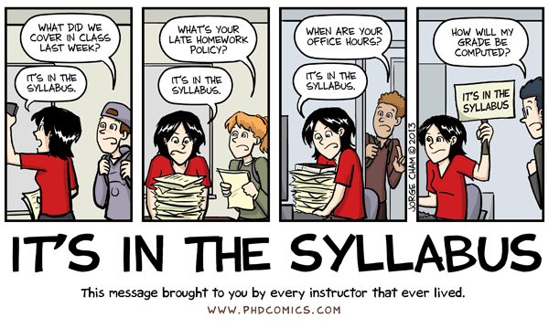

Slide 14
The Primacy of the Quantitative
Numbers make it easy but ….

Slide 15
Validity and Reliability
What matters
Language
Measurement of intangibles
Administration regularities

Slide 16
Evaluating Evaluations
May 20, 2014
By
Colleen Flaherty
Inside Higher ED

Slide 17
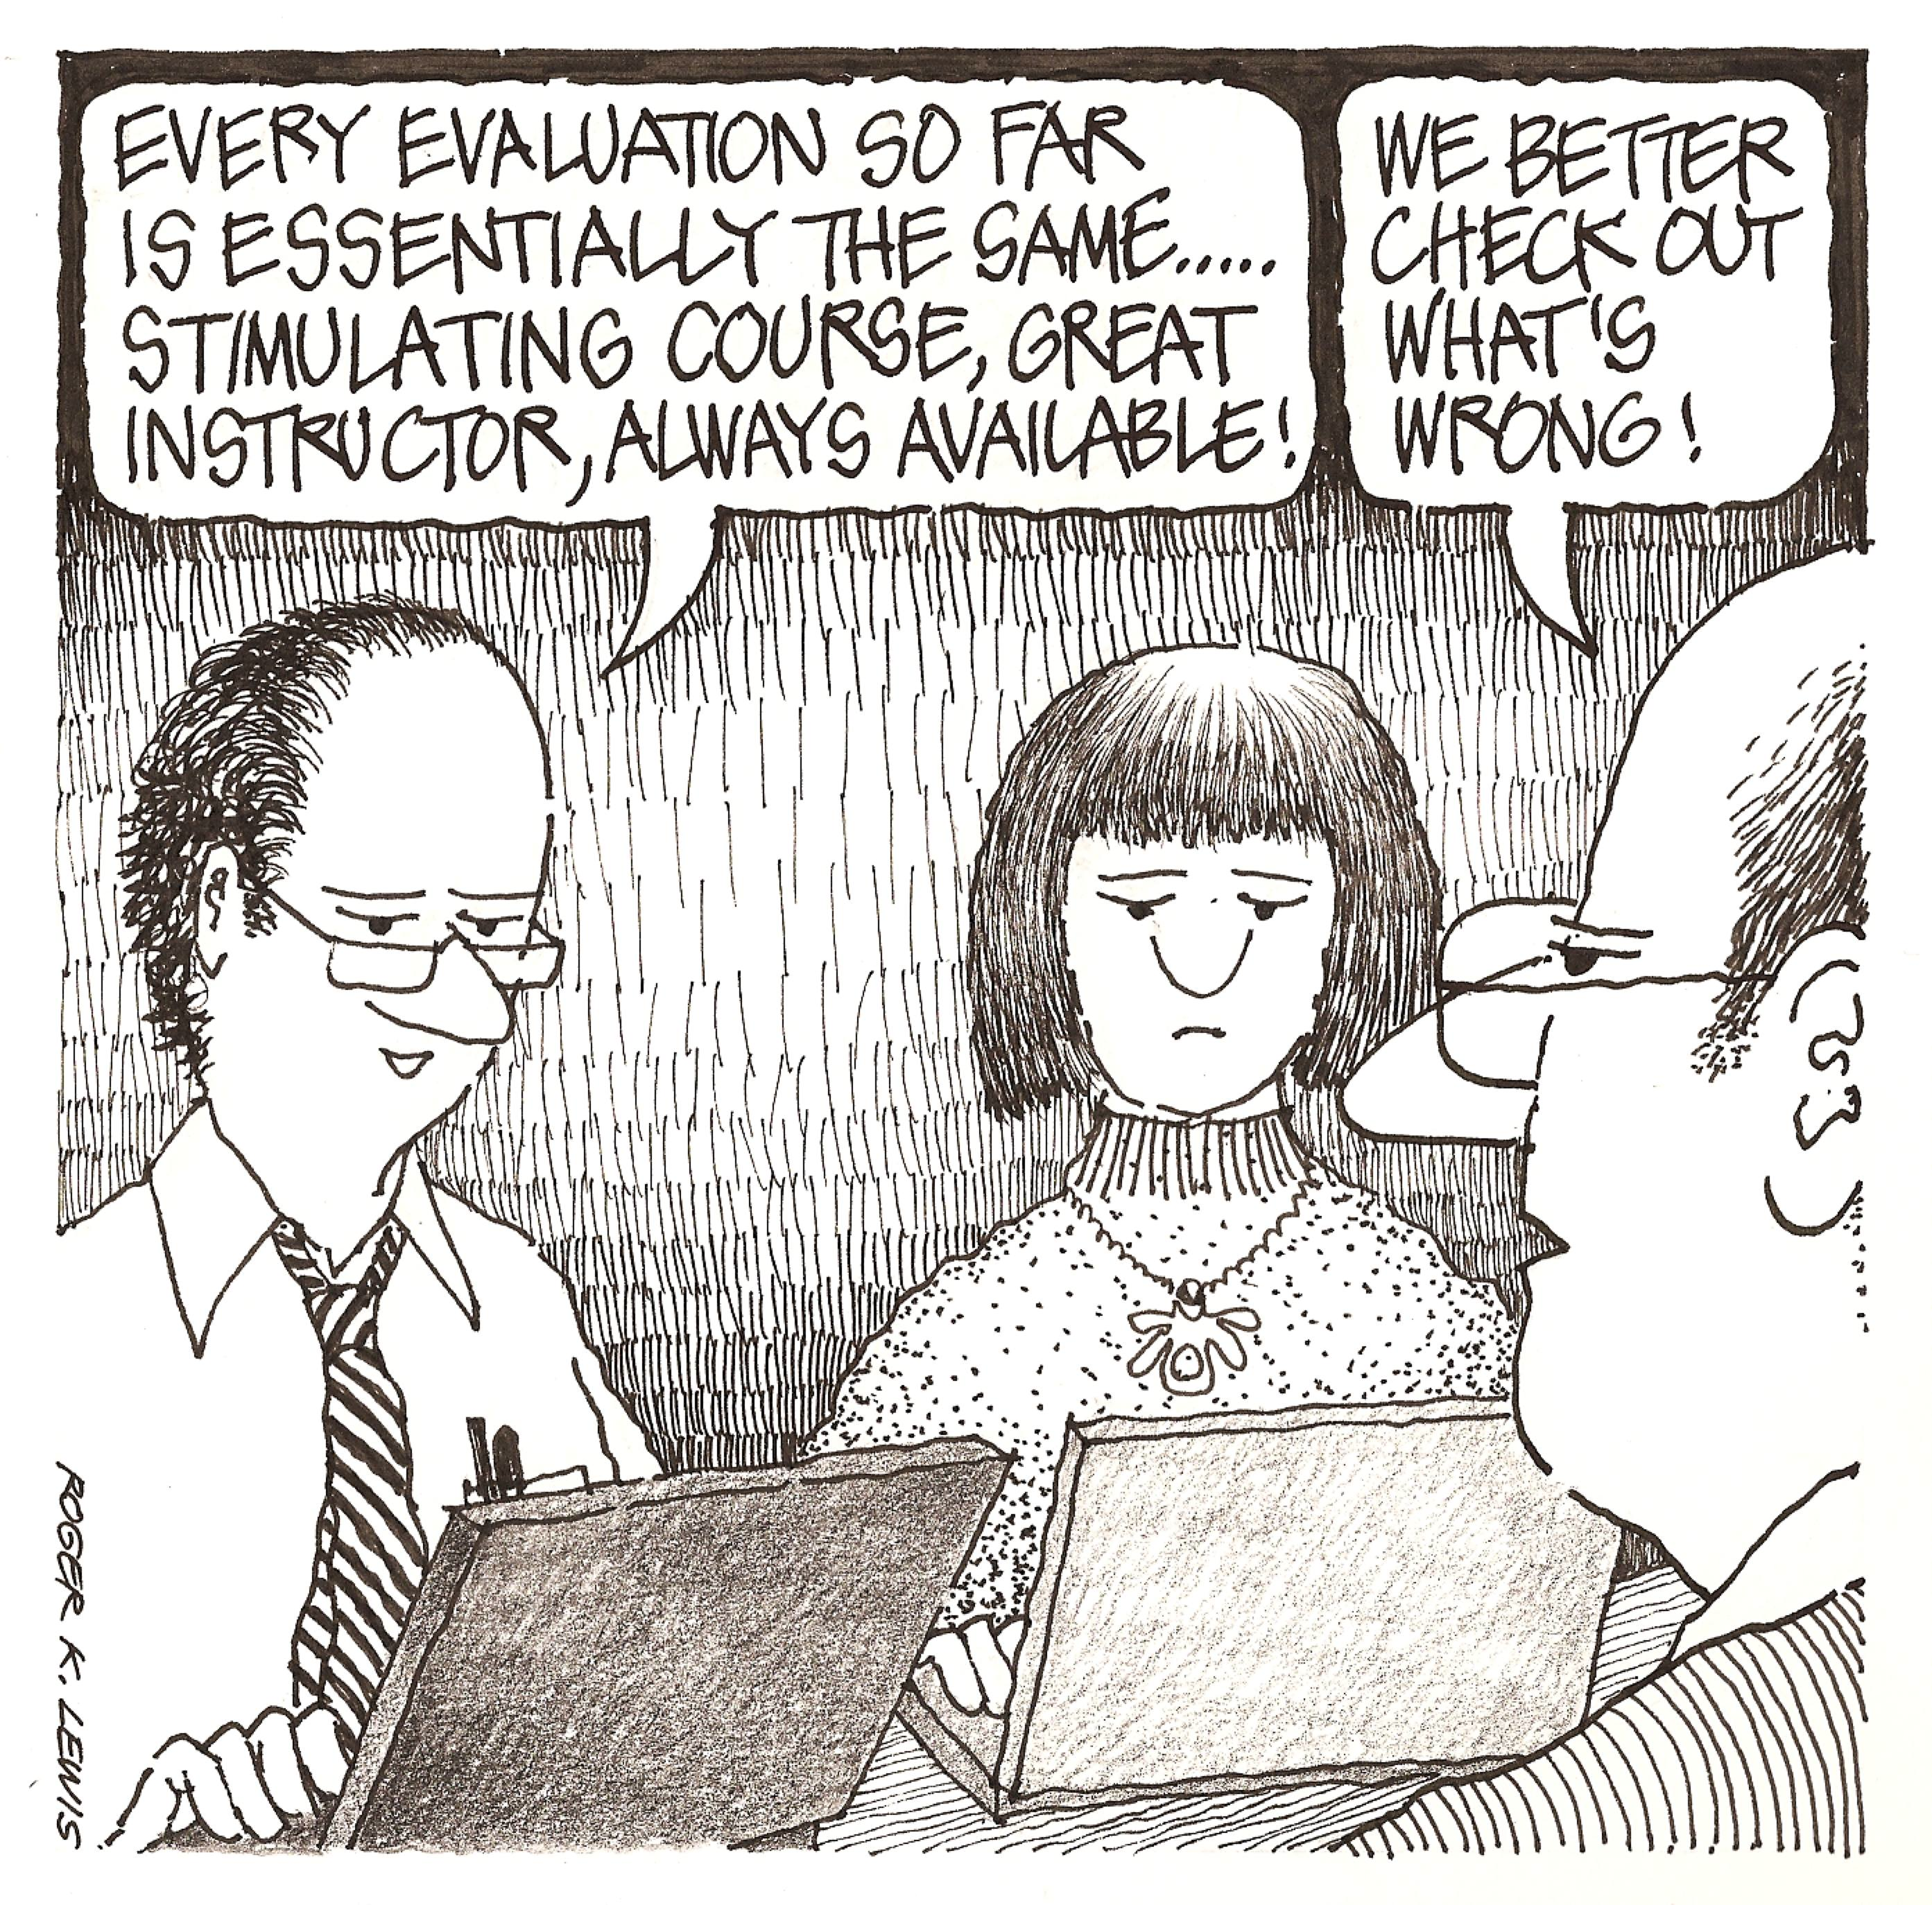
In the hands of the evaluators

Slide 18
What faculty can do
Explain discrepancies
Make your case using all the data at your disposal
Reference the literature and best practice standards

Slide 19
Finding Balance
Guidelines for using qualitative data
Looking at the whole picture
Contextualizing quantitative data

