Slide 1
Strategic Assessment to Support Institutional Viability
Jennifer Fisler, Susan Donat, &
Kris Hansen-Kieffer
Messiah College

Slide 2
Session Objectives
Apply a logic model to guide identification of salient institutional resources, short term outcomes, and intended impact for assessment work.
Identify ways to leverage assessment work to support institutional viability by highlighting and enhancing institutional distinctives.
Notes:
In light of shrinking fiscal resources, growing external accountability, and more consumer-oriented prospective students and families, institutions of higher education must hone, demonstrate, and highlight their educational distinctives in order to remain viable. Strategic assessment work can identify, strengthen, and communicate the essential goals and outcomes of an institution (Russ-Eft & Preskill, 2009). This session equips participants to reimagine higher education as a partnership between faculty, co-curricular professionals, and administration, collaboratively leveraging existing resources to sustain the institution’s viability in challenging economic times.

Slide 3
Session Overview
Macro: Overview of Kellogg’s Logic Model (2004).
Meso: Application of the Logic Model in developing a strategic plan for assessment.
Micro: Application of the Logic Model and strategic assessment plan within a specific campus division.

Slide 4
Kellogg Logic Model
What is it?
A tool to systematically develop and share your understanding of the relationships among:
Available resources
Planned activities
Desired changes/results
(W.K. Kellogg Foundation, 2004)
Notes:
A logic model is a tool that facilitates connecting the dots between resources, activities and results.
It’s a conscious process of articulating challenges ahead, resources available, and the timeline in which to accomplish the task.

Slide 5
Kellogg Logic Model
Resources
Inputs
Activities
Outputs
Impact
Outcomes
Your planned work
Your intended results
Outputs: Types of services to be delivered
Outcomes: Specific changes in participants’ behavior, knowledge, & skills, both short and long-term
Impact: 7-10 years
Notes:
Logic model links short-term outcomes, long-term outcomes, program activities and theoretical assumptions.
Outputs: Direct products of program activities (types of services to be delivered).
Outcomes: Specific changes in participants behavior, knowledge, skills, status and level of functioning. Two types:
Short-term: Achievable within 1-3 years and Long-term: Achievable within 4-6 years
Impact: Change occurring within the institution as a result of program activities within 7-10 years.
Read it as an if/then statement.
What are your resources?
What are your activities?
Impact: to develop an institutional culture of learning
One activity in our model was to develop a strategic assessment plan for the institution. Jennifer will cover. Me – make handouts.

Slide 6
Benefits of using a Logic Model
Program Elements | Benefits of the Logic Model
Planning & Design | Finds gaps in theory/logic of the program and works to resolve them
 | Builds a shared understanding of what the program is about & how the parts work together.
Program Implementation & Management | Focuses attention on the connections between action and results
Evaluation, Communication & Marketing | Way to involve and engage stakeholders in the design, processes and use of evaluation
Notes:
Reveals areas of strengths/weaknesses
Allows you to strategically monitor, manage, and report outcomes throughout the process.
Benefits: increases the practictioners voice in planning, implementation, analysis and knowledge generation.
Provides all participants with a clear map of the road ahead while still being flexible. (adjust approaches)

Slide 7
Fleshing it out
Resources
Outcomes
Impact
Outputs
Activities
Notes:
At Messiah, we knew the next step for our assessment work was build a strategic plan for our assessment endeavors. This type of processing was our jumping off point in developing a strategic plan for our assessment work on the institutional level, which Jenn will discuss.

Slide 8
Fleshing it out
Resources
MISSON STATEMENT
Outcomes
Impact
CULTURE of LEARNING
Outputs
Activities
Notes:
At Messiah, we knew the next step for our assessment work was build a strategic plan for our assessment endeavors. This type of processing was our jumping off point in developing a strategic plan for our assessment work on the institutional level, which Jenn will discuss.

Slide 9
Messiah College Assessment of Student Learning Strategic Plan
Process
Plan Themes
Communication: Developing shared understanding of goals and awareness of progress
Capacity: Building motivation and expertise
Quality: Assessing our assessment efforts to promote continuous improvement
Notes:
Work with the end in mind (Peterson & Vaughan, 2002)
Inductive and collaborative process for identifying broad themes and goals
Balancing the ideal and the feasible
The importance of conversation
After inducing the themes and articulating goals for each, we identified subgoals and discussed at length how those subgoals relate with each other within and across theme areas.
Our three goals emerged organically and in connection to our understanding of the college’s strategic plan, but we can now connect them to Middle States standards and suggestions to advance our assessment work. For example, the emphasis on continuous improvement is a hallmark of accreditation review. We also know that best practices, current trends, and accreditation call for the sharing of learning goals and results.
The strategic plan gives us a filter– is this idea aligned with the plan? If not, do we need to revise the plan and cut someplace else, or do we need to table the idea?

Slide 10
Theme 1: Communication
Mission Statement, CWEOS, ASLC, Marketing, Dissonance
Common language for learning objectives
Shared awareness (internal and external) of learning objectives and progress
# of views of website, partici-pation in events
Marketing strategy, website, educator events
Notes:
Identify ways to leverage assessment work to support institutional viability by highlighting and enhancing institutional distinctives.

Slide 11
How did we get here?
Iterative process
Identify desired impact and work backwards.
Identify unique resources and work forwards.
Notes:
Work with the end in mind (Peterson & Vaughan, 2002)
Inductive and collaborative process for identifying broad themes and goals
Balancing the ideal and the feasible
The importance of conversation
After inducing the themes and articulating goals for each, we identified subgoals and discussed at length how those subgoals relate with each other within and across theme areas.
Our three goals emerged organically and in connection to our understanding of the college’s strategic plan, but we can now connect them to Middle States standards and suggestions to advance our assessment work. For example, the emphasis on continuous improvement is a hallmark of accreditation review. We also know that best practices, current trends, and accreditation call for the sharing of learning goals and results.
The strategic plan gives us a filter– is this idea aligned with the plan? If not, do we need to revise the plan and cut someplace else, or do we need to table the idea?

Slide 12
Bright Spot Evangelizing
“What’s working and how can we do more of it?” (Heath & Heath, 2010)
Student Affairs

Slide 13
Student Affairs Example
Mission , Foundational Values, CWEOS, CAS
6 Student Affairs Outcomes
Students who embody service, leadership and reconciliation
Strategies & Demo-graphic Data
Educational Programs, Services

Slide 14
Objectives & Goal Development

Slide 16
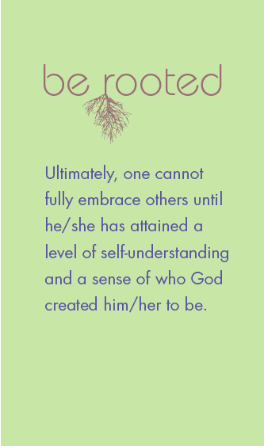
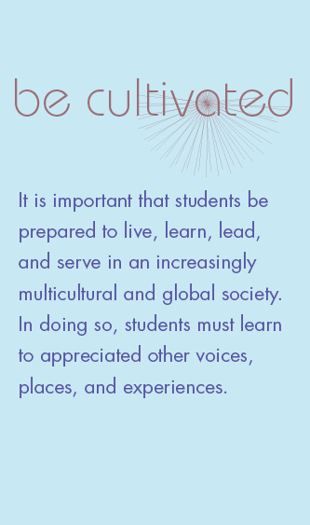
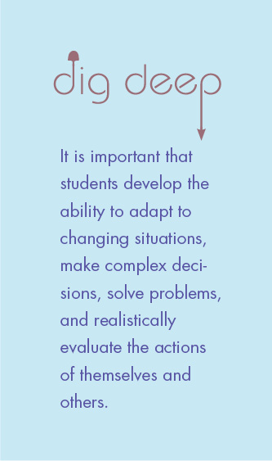
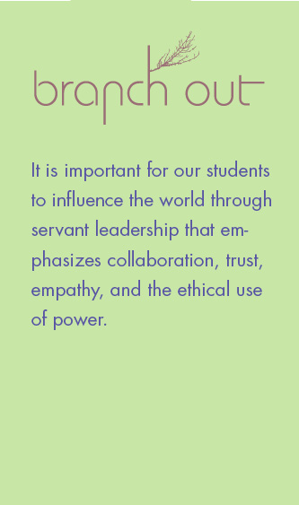
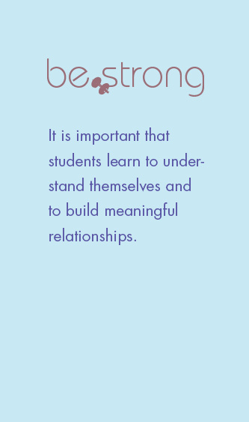

Slide 17
It is important that students develop the ability to adapt to changing situations, make complex decisions, solve problems, and realistically evaluate their own actions and the actions of others.
Messiah College students will…
• Think critically
• Reflect thoughtfully
• Reason effectively
• Maintain intellectual flexibility
Examples of educational programs
• Common Chapel
• Focus weeks such as civil dialogue or healthy sexuality
• Student government association
• Living in community
“When surveying the past four years of my academic career, gratitude is my overwhelming sensation. My academic ‘accomplishments’ have been achieved within a vibrant, supportive community of scholars. . .To be a scholar is to pursue knowledge with perfect fearlessness and perfect humility. To investigate the past humbly and to interpret it boldly is a twofold task which I hope to master more fully in the years ahead.”
—Lucy Barnhouse ’08

Slide 18
Ultimately, one cannot fully embrace others until he/she has attained a level of self-understanding and a sense of who God created him/her to be.
Messiah College students will…
Demonstrate a mature sense of personal attributes such as identity, self-esteem, confidence, and integrity
Mature in their relationship with God in regard to spiritual practices, reconciliation, servant leadership, and embracing life as worship
Examples of educational programs
• Mentoring
• Spiritual Formation House
• Imago Day
• Wilderness trips
“What I believe to be relevant now is subject to change in a heartbeat. But, I take comfort in knowing that a God who was relevant to Abraham and Moses, is relevant today. Although attitudes, societies, and people change, God is current.”
—Lucy Barnhouse ’08

Slide 19
It is important that students be prepared to live, learn, lead, and serve in an increasingly multicultural and global society. In doing so, students must learn to appreciate other voices, places, and experiences.
Messiah College students will…
• Seek diverse communities and understand their value for the common good
• Embrace a willingness to reconcile with God and others
• Welcome diverse perspectives
Examples of educational programs
• Reconciliation House
• Collaborative programs (Harrisburg University and International House)
• Damascus Road antiracism training
• Racial, ethnic, and cultural reconciliation immersion program (RECRIP)
• NCMSLC
“With only four days left in the City of Brotherly Love, I realized that what I’ll take away when I leave this place are the unexpected blessings from the last two semesters: actually enjoying physical labor at the Uber Street garden, . . . befriending people who offend my sensibilities and make me socially uncomfortable, people who have taught me—in ways subtle and quite obvious—that life is not about always saying the right thing or conforming to a rigidly assigned set of social morels. For these simple blessings, I am thankful.”
—Devin Thomas ’09

Slide 20
It is important for our students to influence the world through servant leadership that emphasizes collaboration, trust, empathy, and the ethical use of power.
Messiah College students will…
• Demonstrate responsibility to community, state, nation, world, and faith
• Serve through active involvement with diverse communities and real world challenges
• Develop effective leadership skills and qualities
Examples of educational programs
• Koinonia groups
• Leadership retreats
• Service Day
• Loft Leadership teams
“The business industry is in dire need of men and women of faith. Many in the business world see power — the higher up you are on the corporate ladder — as a god. But God has given us his divine power. The same power that he used to raise Jesus from the dead is the same power at work in us. I can’t help but encourage those around me that God has the power to do anything beyond human imagination.”
—Rachel Hepkins ’08
“The Messiah community, as well as the greater faith community, is stronger together. The more we can inspire, support, challenge, and work beside each other — the greater our impact will be on our home communities and the world.”
—Ryan Glenn ’03

Slide 21
It is important that students learn to understand themselves and to build meaningful relationships.
Messiah College students will…
• Develop dedication to personal goal setting, meaningful relationships, and collaboration
• Develop a sense of ownership over learning and education achievements that can carry over into career and personal goals
• Demonstrate a desire to continue professional and personal development through lifelong discovery
• Be aware of the constantly changing worlds in which we live and the necessity for self-directed adaptation to new opportunities and demands.
• Become agents of reconciliation.
Examples of educational programs
• Student Activities Board
• Residence hall picnics
• The NET
• Recreational sports
“My freshman year I was put into Peer Group 33 and in the freshman seminar class that discusses how God could permit suffering and pain. The people I met the night of the candlelight ceremony who I had that class with and was in a peer group with are still the best friends I have today. Our freshman year, we ate every meal together always having to find a table that would fit about ten of us. Now for the past year we have still gotten together for meals and fun times every other month and feel like we have never been apart.”
-Erin Forney ’07

Slide 22
Ultimately, students will be able to live lives that are purposeful, satisfying, and effective as they follow God’s calling.
Messiah College students will…
• Communicate effectively
• Manage personal affairs
• Be economically self-sufficient
• Maintain personal health and wellness
• Prioritize leisure pursuits
• Live a purposeful life
Examples of educational programs
• Off Campus housing orientation
• Intercollegiate athletics
• Bouldering Wall
Harrisburg Shuttle program
“It’s okay to take a deep breath every so often.”
—Dan Custer ‘09
“ I joined the cross-country team as one of eight first-year students, and throughout my diverse college experience, these girls remained my best friends and roommates. . . . Being a member of a team requires putting forth your best effort, displaying consistency, maintaining a positive attitude, and opening yourself before your teammates. My teammates at Messiah served as continual reminders to love running, love one another, and love God.”
—Elizabeth Monachello ’08

Slide 23
Participants
What are you trying to accomplish and which tool works for you?
Notes:
Get into three groups:
[Susan] just getting started– how does this model help me with my assessment work? Long term framework (8-10 years)
[Jenn] Shorter term strategic plan for assessment application (2-4 years)
[Kris] Division or program specific application (1-3 years)

Slide 24
Contact information
Susan Donat
Assistant Director of Curriculum and Assessment
sdonat@messiah.edu
Jennifer Fisler
Director of Academic Assessment,
Professor of Education
jfisler@messiah.edu
Kris Hansen-Kieffer
Vice Provost, Dean of Students
hansen@messiah.edu

Slide 25
References
Kuh, G.D., Hinkle, S. E. (2002) Enhancing student learning through collaboration between academic affairs and student affairs. In Field Guide to Academic Leadership. R. Diamond (ed). P. 311-327. Jossey-Bass San Francisco, CA.
Lick. D. W. (2002) Leadership and change. In Field Guide to Academic Leadership. R. Diamond (ed). P. 311-327. Jossey-Bass San Francisco, CA.
Lick, D.W. (2006). A new perspective on organizational learning: Creating learning teams. Evaluation and Program Planning Volume 29, Issue 1, February 2006, Pages 88–96
W.K. Kellogg Foundation (2004). Kellogg Model Handbook. www.wkkf.org
Peterson, M. W. & Vaughan, D.S. (2002). Promoting Academic Improvement in Building a Scholarship of Assessment. Banta, T.W. (Ed.) Jossey-Bass San Francisco, CA
Russ-Eft, D. & Preskill, H. (2009). Evaluation in organizations: A systematic approach to enhancing learning, performance and change, 2nd edition. Basic Books, New York, NY.

