Slide 1
Strategic Points of Entry Towards a Culture of Meaningful Assessment
Drexel University Regional Assessment Conference
September 12, 2014
Eric Kaldor
Robert Baker
Ruth Childs
http://tinyurl.com/Brockport-Assess
Notes:
Good morning – I’m Eric Kaldor and I am currently Interim director of Brockport’s Center for Teaching and Learning. Prior to that I’ve taught in the sociology department and worked extensively on Brockport’s General Education Team

Slide 2
What is a culture of meaningful assessment?
Assessment: observation and analysis of student learning to enable growth and improvement
Meaningful: (see also genuine, authentic) provides information that members can use in pursuit of improved student learning
Culture: a way of doing things that is widely shared and deeply ingrained in the understanding and everyday practices of members

Slide 3
Why is this so hard to achieve?
Clash in two forms of rational administration
Assessment often develops on campus through bureaucratic policies and directives
Faculty are deeply embedded in professional traditions of quality control
Strategic Response:
Build institutional commitment to assessment based on culture of inquiry (Maki, 2010)

Slide 4
Three Strategic Points of Entry
At the Administrative-level
How to help move from cynical to sincere assessment
Program-level
How to integrate external mandates with authentic inquiry
Interdepartmental/Cross-campus
How to build shared understanding and practices in miniature with an essential learning project

Slide 5
Cynical and Sincere Assessment
Sociologist Erving Goffman described social life in terms of performances
Role defined by the expectations of specific audiences in specific situations
Sincere performance
When we really believe the role we are performing is who we are
Cynical performance
When we strive to convince an audience that we are a role we do not believe we really are
Notes:
Audience expectations are critical to Goffman’s theory of social interaction.
Cynical performances are not the same as self-interested or manipulative

Slide 6
Some Possible Configurations
Administrators | Faculty/Staff
Cynical | Cynical
Sincere | Cynical
Cynical | Sincere
Some Sincere | Some Sincere
Sincere | Sincere

Slide 7
In what ways are cynical expectations for assessment communicated to faculty?
Please form a small group
Consider both formal and informal communication
Words
Actions
Justifications
Control
Resources
Time

Slide 8
How can we turn cynical expectations into sincere expectations?
Identify your top three examples of cynical expectations communicated to faculty
Take your top ranked example and explain how an administrator could communicate sincere expectations for meaningful assessment

Slide 9
Developing Meaningful Assessment at the Program-level

Slide 10
College Composition: A Brief Case Study . . .
. . . in meeting external requirements while simultaneously developing useful assessment data
The field of composition has a history of developing direct assessment activities
Argumentative research papers represent the culminating project in College Composition
The SUNY 10 includes Basic Communication

Slide 11
Three SUNY SLOs in Basic Communication:
Students will:
produce coherent texts within common college-level written forms;
demonstrate the ability to revise and improve such texts;
research a topic, develop an argument, and organize supporting details;

Slide 12
SLO 1 rubric

Slide 13
SLO 2 rubric

Slide 14
SLO 3 rubric

Slide 15
External Requirements can Facilitate Cohesion
Multiple Measures provide more useful data
Instructional Materials Rubric
Syllabus
Assignment sheet
Rubric
SUNY SLOs facilitate correlation between instructor input and student outcomes.

Slide 16
Instructional Materials rubric

Slide 17
Closing-the-Loop
2013
Only 61% of students were meeting or exceeding expectations for revision
Only 38% of assignment sheets discuss revision
Orientation: screening of the film Beyond the Red Ink
Fall Article of the Semester: Responding to Student Writers by Nancy Sommers, and faculty workshop.
Spring Article of the Semester: “Improving Student Peer Feedback,” and roundtable discussion.

Slide 18
Closing-the-Loop
2014
Refutation and Revision are not sufficiently mentioned in Instructional Materials
Orientation: faculty reworked their syllabi, rubrics, and assignment sheets
2015
“Structure” had the lowest score in SLO1.
Few syllabi mentioned Structure
Spring Semester roundtable discussion

Slide 19
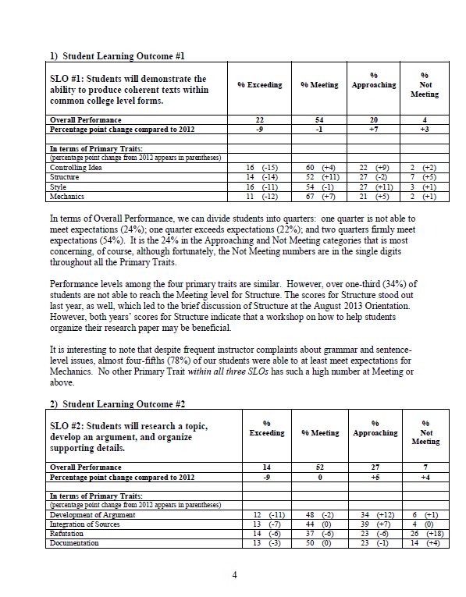
The annual assessment report not only reviews the recent assessment results, it also facilitates planning for the upcoming year

Slide 20
Individual Journaling
Think of at least one externally defined learning outcome your department or program must assess.
How could you gain genuinely useful data about student learning while also reporting on the above externally mandated outcome?

Slide 21
Using an Essential Learning Project to Generate Cross-campus Conversations

Slide 22
A Rubric as Catalyst for Change
Grassroots path to campus-wide culture can grow from a narrowly-defined project
Build upon an existing campus-wide concern about the quality of student learning
Focused project on evaluation of a nationally validated rubric
The AAC&U VALUE Rubrics
Valid Assessment of Learning in Undergraduate Education

Slide 23
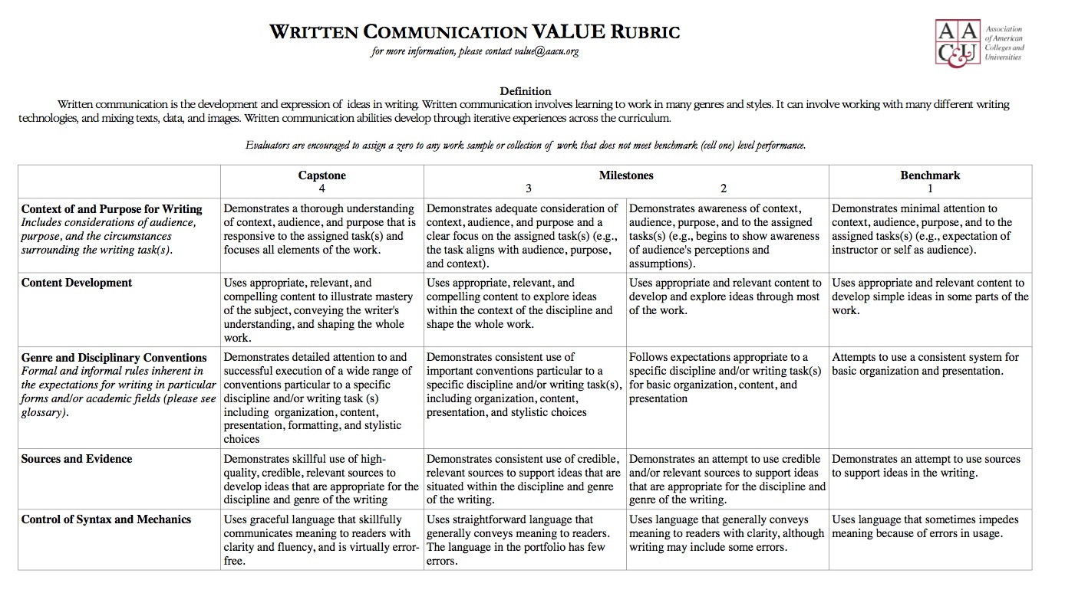

Slide 24
Why Choose the VALUE Rubrics?
Interdisciplinary design critical to develop a shared language across departments
External document – not owned by any internal group
The 16 rubrics allow for future projects focused on a variety of Brockport’s institutional learning outcomes

Slide 25
Exploring VALUE Rubrics
Team from variety of disciplines participated in Learning to Write, Writing to Learn project
Reviewed Written Communication VALUE Rubric (WCVR) to establish shared meaning
Compared WCVR to other internal and external rubrics
Evaluated how to use WCVR assessing many different types of assignments

Slide 26
Softly Sharing the VALUE Rubric
Brought Peggy Maki to campus
Developed in-house materials to support Brockport faculty using the WCVR
Held open conversations with team in coffee shop – “bring your assignments”…
Disseminated findings and resources through our center for teaching and learning (CELT)
Gentle outreach and modeling by team members

Slide 27
Next Steps in Essential Learning Project
Spread common language across campus for discussing writing
Share ownership of writing and teaching writing across disciplines and at all levels
Build expectation that faculty take time to teach writing and give students time to practice writing
Plan cross-campus assessment of student writing
Plan our next VALUE Rubric Roll out – Quantitative Literacy

Slide 28
Step 1: Identify a major learning outcome that you think concerns faculty and staff across your campus.
Inquiry and analysis
Critical thinking
Creative thinking
Written communication
Oral communication
Reading
Quantitative literacy
Information literacy
Teamwork
Problem solving
Civic engagement
Intercultural competence
Ethical reasoning
Foundations for lifelong learning
Global learning
Integrative Learning
http://www.aacu.org/value/rubrics/

Slide 29
Step 2: Identify potential team members for an essential learning project
Look for
Diverse departments/offices
Some key senior faculty/staff (reputation important)
Some junior faculty/staff
Try to include some potential critics

