Slide 1
USING HIGH RISK STUDENT ASSESSMENT METHODS TO IMPROVE STUDENT OUTCOMES
Presented by:
Assistant Dean and Assistant Professor Jennifer Dahlman, RN, MSN
Assistant Dean and Assistant Professor Danielle Artis, RN, MSN, CPN
Trinity Washington University
Notes:
The information in this session is intended for educators in institutions of higher learning who recognize the needs of today’s students. The material presented will be applicable to both general education and nursing programs. The presenters do not have any bias in, and are not receiving any payment as a result of, this presentation.

Slide 2
Notes:
Meeting the needs of the changing demographics of our student population in higher education requires a shift in the approaches used to assess high-risk students. Incorporating new assessment methods for high-risk students that are formative, ongoing, and holistic is essential to improving student outcomes. Vital to a student’s success is the perception of the challenges they must face, as well as the efforts and commitment they must make to overcome these barriers.

Slide 3
Objectives
Upon completion of this presentation faculty in all disciplines of higher education will be able to:
Identify the characteristics of a high-risk student
Identify the barriers and challenges when faced when standard assessment methods are applied to high-risk student groups.
Identify missing elements of current assessment strategies as they are applied to the current high-risk population.
Implement new assessment methods to approach high-risk students attending institutions of higher learning.

Slide 4
What are the characteristics of a high-risk student?
Notes:
In order to understand what we are assessing for, we must understand what constitutes a high-risk student…
You will notice a stack of notecards in front of you, please take the first one, and write down one word. My colleague will come around to collect them.
Instruct participants to write one characteristic on their note card.
Collect and write on white board.

Slide 5
How many of these characteristics are academic?
McGann and Thompson (2008) state “Grades, prerequisite science and math scores, standardized exams, and GPA have been used to identify at-risk-students.”
CHALLENGE!
How many of these can be described as
non – academic?
Notes:
We would like to challenge the literature to include the whole person-holistic
Do you know what the indicators are for your discipline?

Slide 6
What barriers or challenges do high-risk students face?
Notes:
Again, ask participants to write a challenge on their notecard, collect them, and write answers on white board.
Rationale for assessing non-academic factors that impact high-risk students-Learning is something students themselves do. It is the direct result of how students interpret and respond to their experiences, past and present. The view that our adults learners come from different walks of life and have different prerequisite courses may have an impact on the learning process; this prior knowledge can help or hinder learning.
A students’ current level of development interacts with the social, emotional and intellectual climate of a course to impact learning. We must be aware of academic and nonacademic factors of each student in our courses when doing an assessment.
Consumer, non-traditional adult students on average exist in academia. (stat?)
Students want to feel like you can identify with their struggles.

Slide 7
How do you currently assess for high-risk characteristics, barriers to learning, and readiness ?
Are you assessing these and not even aware ?
Should all students be considered high risk ?
Notes:
All the literature in all the disciplines agree, early assessment provides early identification of students who are at-risk of passing a course, or succeeding in a program, and allows ample time for faculty to make a difference.
“Keep your friends close, but your enemies closer.”
“Keep your star students in your sights, but keep your trouble-makers closer.”
-Who are your time-consuming students?
-Assessment can be a counter to time barriers for faculty!!

Slide 8
Notes:
We would like to share our story with you…
Novice assistant professors learning from their mistakes. What path you choose to take can make your life easier or harder down the road.

Slide 9
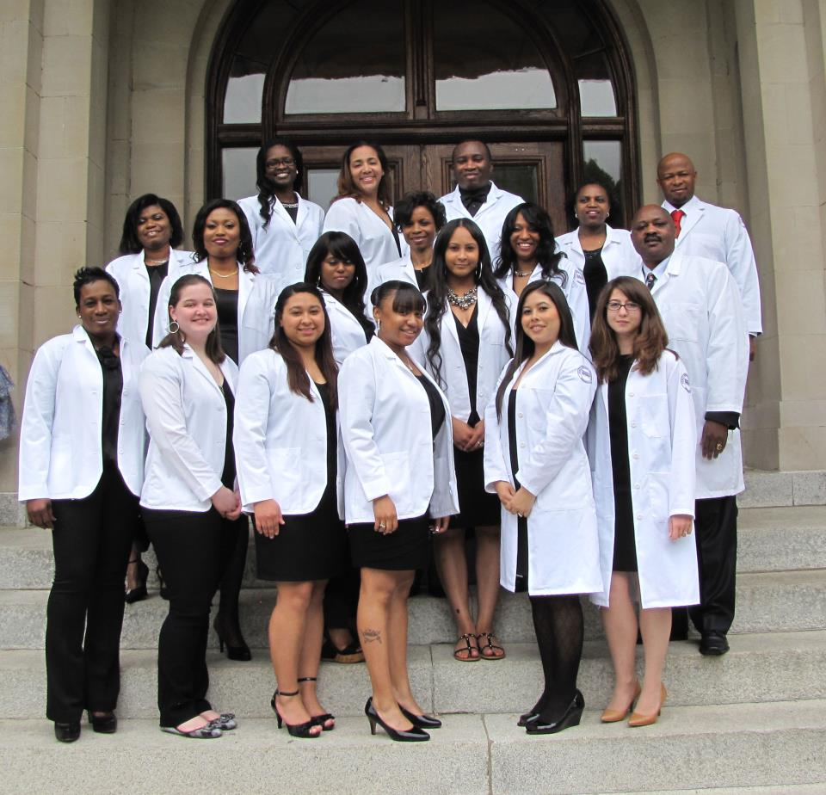
Trinity Demographics
Notes:
We would like to share the characteristics of our student population at Trinity Washington University as a model for high-risk students in institutions of higher learning.
Trinity today educates a student body that is nearly 90% Black, Hispanic, Asian and international, reflecting the population of the District of Columbia and many communities in the Washington region. About 75% of Trinity’s students are over the age of 25. 95% of the fulltime undergraduates receive financial aid from Trinity, and virtually all students receive some form of federal and local financial aid. Nearly half of Trinity’s undergraduate students are citizens of the District of Columbia.
-2006 Middle States Self-Study. Assessing Trinity 2000-Approaching Trinity 2010.
Updated information:
Student body of 2,500 students is more than 95% Black, Hispanic and multi-racial.
75% of the students are Pell Grant recipients. 100% receive some form of financial aid, including more than 95% of full-time students receiving Trinity grants.
The annual median family income of the full-time students is $25,000.
More than 50% of all students are D.C. residents, with most being graduates of the D.C. Public Schools which are well known for academic deficiencies. Another 30% are residents of Maryland with a substantial proportion being graduates of the Prince Georges County Public schools which also pose substantial academic risk factors for our students.
Trinity’s women’s college today, the College of Arts and Sciences, is the largest academic unit with more than 1,000 full-time women. Trinity also offers undergraduate opportunities for working women and men through the School of Professional Studies, where about 700 part-time adults enroll in associate and baccalaureate programs. Trinity’s coeducational School of Nursing and Health Professions has about 150 students in Nursing (BSN, RN-BSN) and OTA programs. Trinity also offers coeducational graduate programs.
Lead into assessment here…

Slide 10
ASESSMENT NEEDS TO START BEFORE DAY 1!

Slide 11
Astin’s Theory of Student Involvement (1999)
Impact on student retention and graduation
The more a student is involved and committed in their learning, the more success they will realize.
Student’s responsibility to become actively involved in order to learn and succeed
Students that are connected, engaged and involved in their learning, regardless of content, experience higher rates of success. (cite?)

Slide 12
Assessment Methods:
Course Entrance Exam
Study Needs Survey (Self-Assessment)
Learning Styles
1:1 Meetings – The Learning Contract
With benchmarking throughout!!

Slide 13
Implementation Timeline
Prior to the 1st
day of class
Course entrance exam
First day of class
Study Needs Self-Assessment
1:1 Meetings
-Encouragement
-Learning Contract
-Benchmarking
Course Exams
Reassessment
1:1 Meetings
- Encouragement
- Learning Contract
- Benchmarking
Final Exam
Learning styles

Slide 14
Course Entrance Exam
Pre- or Diagnostic Testing
Know-Want to –Learn Charts (KWL)
Confront misconceptions
Notes:
How do you know what to teach?

Slide 15
Self Assessment Survey
Identify about their areas that are weak and strong
Managing test-taking anxiety
Time management
Study methods
Plan for actual testing day
Computer Adaptive Testing (CAT)
Notes:
Self-Assessment allows for the faculty and student to customize a plan unique to their learning style.

Slide 16
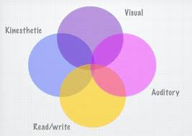
Learning Styles
Student-centered
5 Common Used Learning Style Models
What type of learners are nurses? (stat)
Other disciplines? (stat)
VARK
Notes:
Student-Centered
Where does our own teaching style come from?
Student techniques such as this one is better than trying to have the student convert faculty information into a meaningful format some students don’t have the skills to do this?
We cant teach them the way we were taught?

Slide 17
Learning Styles of Various Disciplines

Slide 18
1:1 Meetings
Address academic & non academic factors
Ongoing support
Open communication
Demonstrate commitment that faculty has to individual success
Identify risk
Empowerment
Attitude & culture changes related to college
Notes:
What are the different terms you call a faculty person that is authentically involved in your education?
Outcome or other names of having 1:1 with students. You may be also called a coach, ect.
Faculty must be willing to become involved with students in an authentic way, and the skill to express one self in a language understood by students.
Student must access and mobilize resources and recognize their unique abilities, needs and risks in this process.

Slide 19
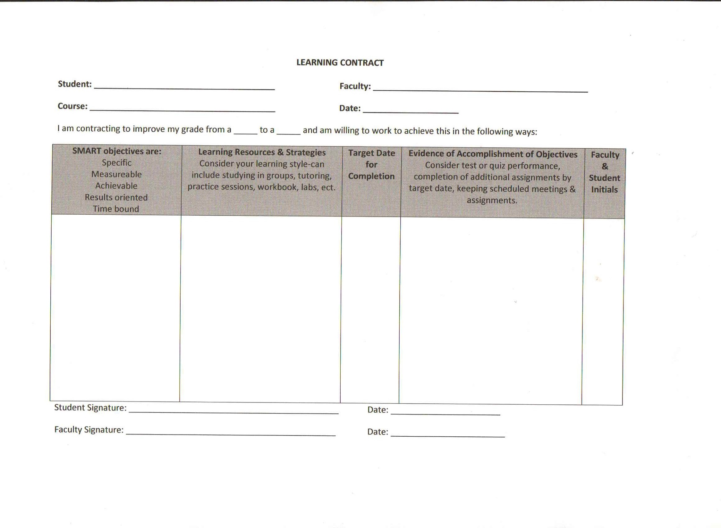
Notes:
How many of you currently use a learning contract?
Learning contract is a working document, used multiple times throughout the semester.
Hold the student accountable to themselves and encourages them to take ownership of their grade.
Benchmarking
(Eliminates time spent arguing a grade a the end of a course as well.)

Slide 20
Supplemental Instruction (SI)
Voluntary
Focus is on “difficult courses” versus “at-risk” students
Begins week one of class!
Emphasizes collaborative learning
Takes place outside of the classroom
For more information please visit:
http://www.umkc.edu/asm/si/index.shtml

Slide 21
As of December 2013 ATI Predictor Required to Graduate
+ NCLEX Learning Contracts

Slide 22
Trinity Student Outcomes over Four Years
As of December 2013 ATI Predictor Required to Graduate
+ NCLEX Learning Contracts

Slide 23
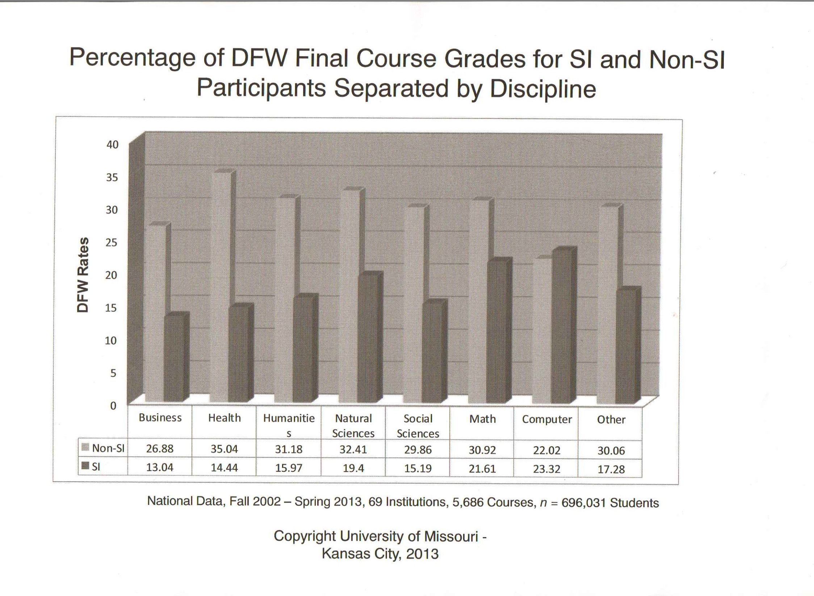
SI National Data

Slide 24
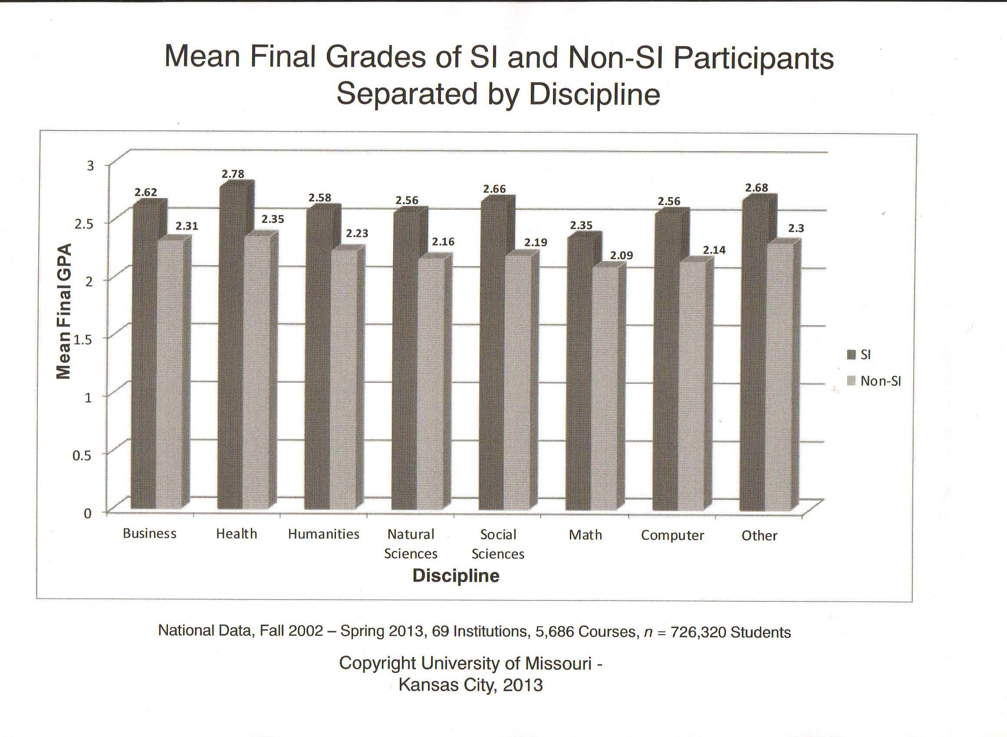
SI National Data

Slide 25
Notes:
In conclusion…
Supplemental instruction (SI) methods requires the student to become more engaged in their own learning, recognizing them as an individual, and provides the student with a framework to improve their own outcomes. Vital to a student’s success is the perception of the challenges that they must face, as well as the efforts and commitment they must make to overcome these barriers.
Faculty need to be mentors and facilitators, but not barriers.

Slide 26
Students are more likely to _______________ when assessment demands ______________.
Notes:
Succeed; Active Engagement
Engaged; Self-Assessment

Slide 27
Works Cited
Ambrose, S., M. Bridges, M. DiPietro, M. Lovett, & M. Norman. (2010). How Learning Works: 7 Research-Based Principles for Smart Teaching. Jossey-Bass; San Francisco.
Anderson, R. (2007). Individualized student advisement for preparation for the National Council Licensure Examination for Registered Nurses: A community college experience. Nurse Educator; 32, 3, 117-121.
Higgins, B. (Dec 2005). Strategies for lowering attrition rates and raising NCLEX-RN pass rates. Journal of Nursing Education, 44, 12, 541-547.
Lockie, N., Van Lanen, R., & T. McGannon. (Jan/Feb 2013). Educational implications of nursing students’ learning styles, success in chemistry, and supplemental instruction participation on National Council Licensure Examination-Registered Nurses performance. Journal of Professional Nursing, 29, 1, 49-58.
Lohri- Possey, 2003
Lockie, N. & R. Van Lanen. (2008). Impact of the supplemental instruction experience on science SI leaders. Journal of Developmental Education; 31, 3, 2-14.
Marek,
McGann, E. & J. Thompson. (2008). Factors related to academic success in at-risk senior nursing students. International Journal of Nursing Scholarship; 5, 1, article 19.
McTighe, J. & K. O’Connor. (Nov 2005). Seven practices for effective learning. Assessment to Promote Learning; 63, 3, 10-17.
Stark, M, Fiekema, B. & Wyngarden, K. (2002). Teaching strategies empowering students for NCLEX success self assessment and planning. Nurse Education; 27, 3, 103-105.

