Slide 1
Promoting Effective Assessment Practices Through Peer Review
Claudia J. Stanny
Director, Center for University Teaching, Learning, & Assessment
Amy Mitchell-Cook
Chair, Department of History
Drexel University Assessment Conference
Myths & Movements: Reimagining Higher Education Assessment
Philadelphia, PA
September 11, 2014

Slide 2
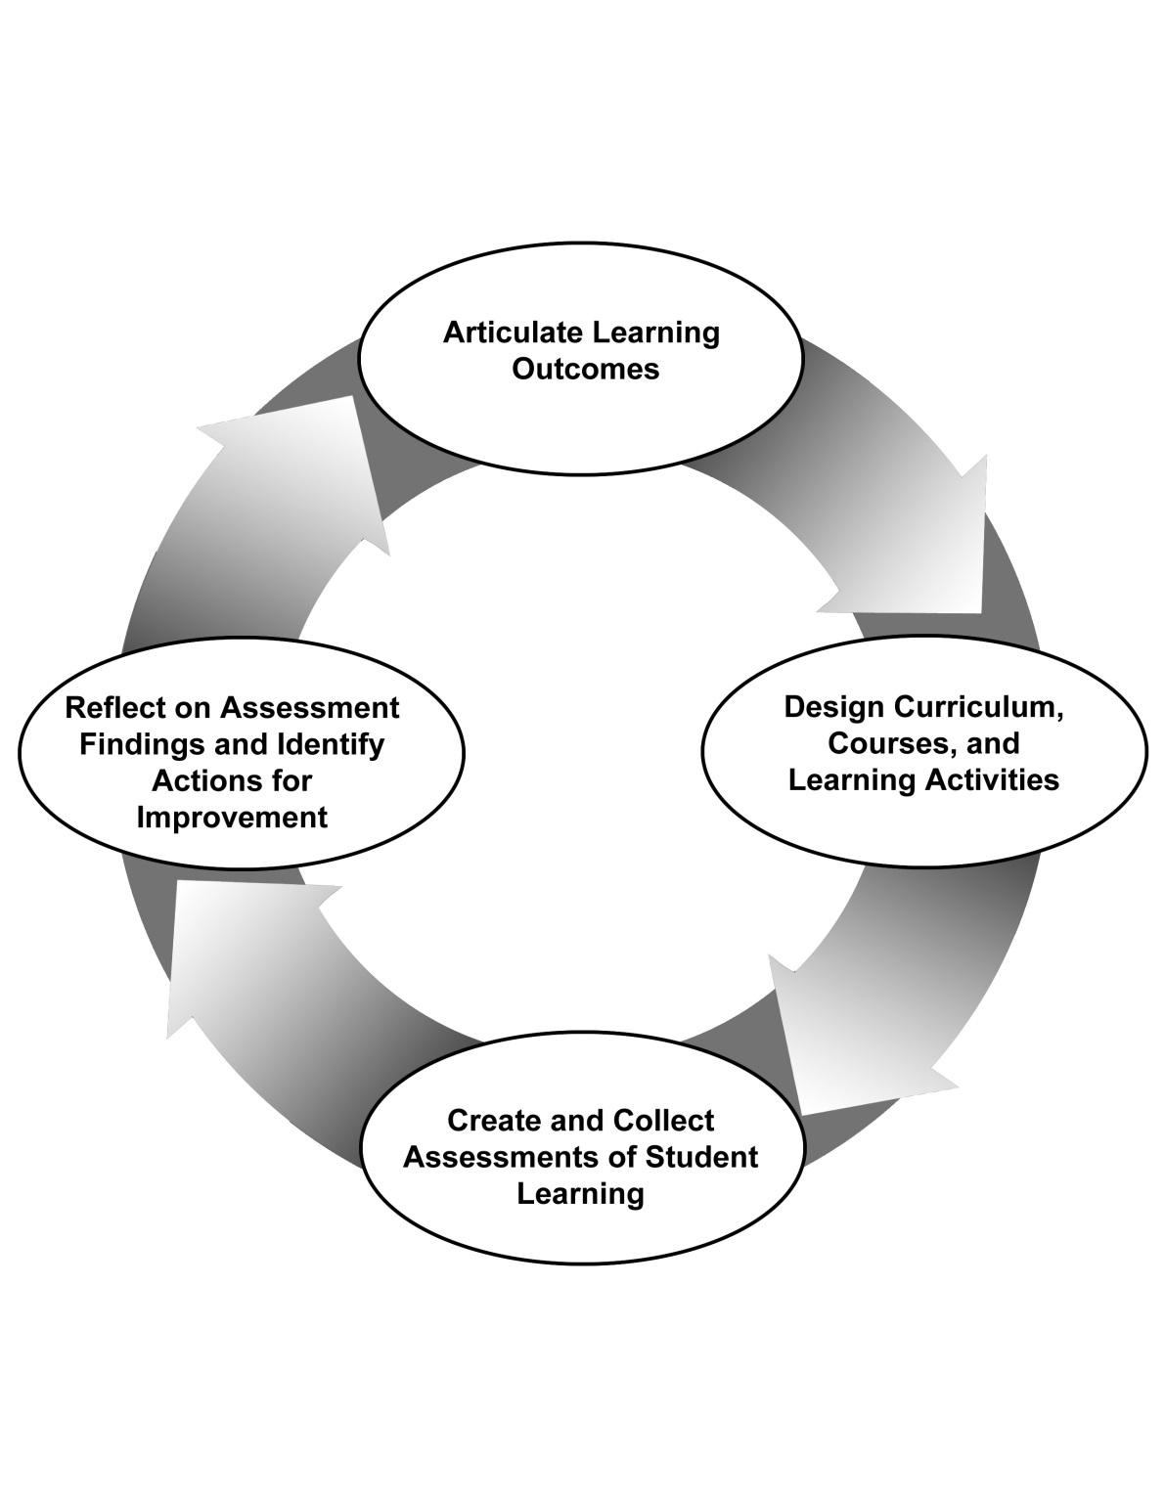
Model for Assessment at UWF
Take actions & commit to next cycle
Identify SLOs
Reflect on findings & make decisions
Articulate an assessment question & gather data

Slide 3
Department Annual Report documents steps in the assessment cycle
Identify the student learning outcome(s) assessed
Describe direct measure(s) used
Brief summary of findings (strengths & weaknesses)
Describe any indirect measures used & findings
Describe use of assessment evidence for making decisions about student learning
Describe evidence-based decisions to improve quality of future assessment work
Commitment to assessment activity in next cycle

Slide 4
Departments report annually on 1 – 4 areas of SLO assessment
General Education
Undergraduate Programs
Graduate Programs
Certificates and Stand-Alone Minors

Slide 5
Peer Review of Assessment
Based on a model used at Marquette University
Bloom, Dooley, Krueger (2011)
All academic departments participate annually
Small group facilitated discussion of assessment:
General Education (2 tables)
Undergraduate Programs (2 tables)
Graduate Programs (1 or 2 tables)
Certificates and Stand-Alone Minors (1 table)

Slide 6
Structure of the facilitated discussions
Small group discussion; 4-6 departments per table
Table discussion focuses on one area of assessment
Table assignments create a diverse mix of disciplines and colleges for optimal peer instruction
Department representatives review materials for all peers in advance of the review
Departments participate in a different area of assessment each year, rotating to address all areas over a 3-4 year period

Slide 7
Department discussions (30 min each)
Department Representatives:
Present a brief summary of assessment work in assigned area (5-10 minutes)
Share rubrics or other assessment tools or procedures
Peer Reviewers:
Provide feedback on the assessment work, use of data, effectiveness of documentation (15-20 minutes)
Peers often request information about rubrics and assessment methods used and potential for adoption in their discipline

Slide 8
Role of facilitators during peer review
Manage the discussion at the table
Keep time, ensure all programs have time for presentation, discussion, and feedback
Keep the discussion collegial and focused on discussion of assessment methods and strategies to use evidence to guide decisions
Take notes to document the discussion
Area assessed
Assessment methods used
Strengths and weaknesses in student learning
Strengths and weaknesses in assessment processes
Use of evidence for decision making
Wrap-up discussion
Identify best practices to share with the room

Slide 9
Facilitator training
Discuss the strategies for the facilitation process
Keeping group on time
Maintaining focus
Maintaining collegial discussion
Discuss mechanics of taking notes on a laptop
Some facilitators arrange to delegate note-taking to a scribe
How to prepare notes for post-review summary

Slide 10
Participant training
Pre-review Mailing to Department Chairs
Central web site for storing documents
Information on how to upload and access
Ground rules for the discussion
Rubric for formal feedback (pre-review)
Pre-review Information Sessions for participants
Review of the rubric
Q & A about the peer review process

Slide 11
Follow-Up Activities
Debriefing meeting with table facilitators
Identify strengths and weakness of the review
Identify modifications to improve next peer review
Compile facilitator notes in a single summary report, distributed to all chairs & deans

Slide 12
Peer Review discussions are collegial
2013 Peer Review of Assessment
43 participants
34 departments
10 facilitators & staff
7 administrative visitors
Post-Event Evaluation
(28 responses, 46.7% of all 60 attendees)
Discussion was collegial:
Most or All of the Time (93%)
Frequently (7%)

Slide 13
Perceived impact on assessment

Slide 14
Perceived Impact on teaching & learning

Slide 15
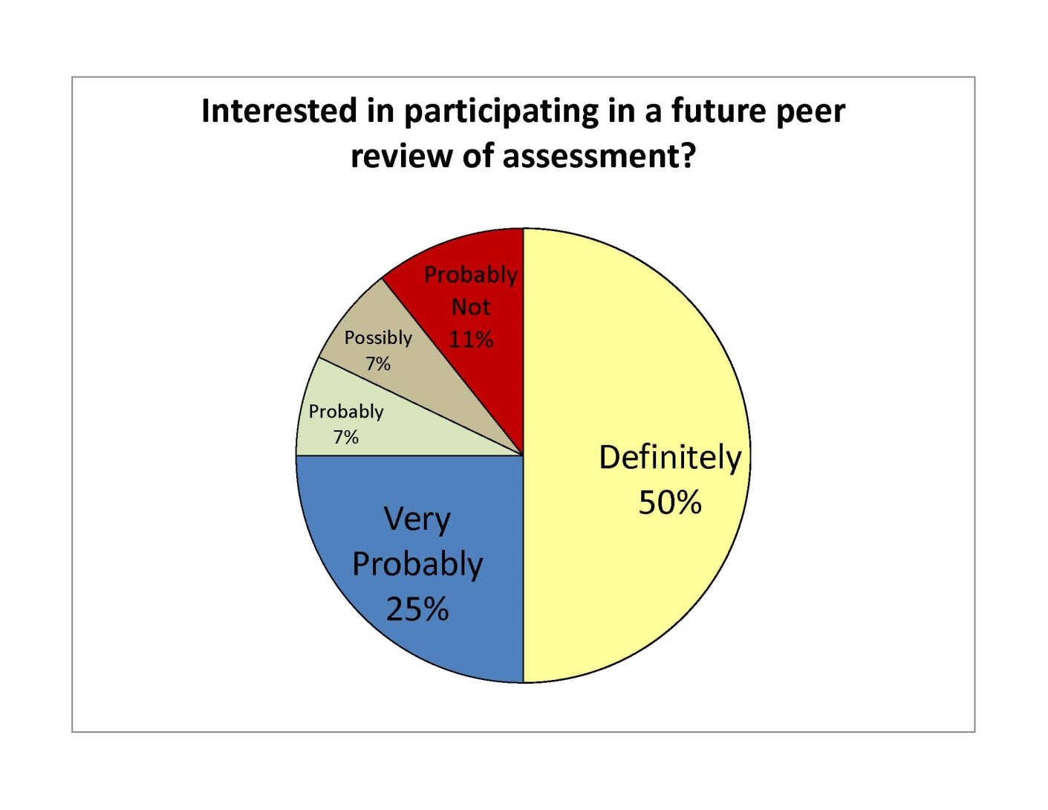
Strong interest in future peer reviews

Slide 16
Simulating a Peer Review of Assessment
Handouts: Assessment report summary for 3 departments (paper colors code the departments)
Locate 3-4 people who have the same handout
Designate one person as the department representative, one person as the facilitator, and others as peer reviewers.
Spend about 5 minutes on a summary of the department’s assessment work
Identify strengths and suggest areas for improvement

Slide 17
Discussion
What were some of the good assessment practices described in your discussion?
What were some of the suggestions made?
To improve assessment processes or
To improve student learning on the outcome(s) assessed

Slide 18
Challenges and Promises at UWF
Challenges
Departments are reluctant to report rubric data on the assessment work of their peers
Managing time during the discussion
Managing the task of facilitating and taking notes
Ensuring a full-room discussion at the close of the peer review
Promises
Development of assessment skill: Peers share strategies and best practices
Discussion focuses on the value of assessment work for curriculum improvement
Promotes cross-disciplinary collegiality

Slide 19
Implementing a peer review on your campus: What are the challenges and promises?
Challenges Promises
http://uwf.edu/offices/cutla/

